Slide 1


Cryptography Submitted to: Dr. Mona Helmy

Slide 2
Contents
Crypto++ Library
Install crypto++
Include in CmakeLists.txt (hard way)
Include in CmakeLists.txt (soft way)
Security Concepts
Confidentiality
Authentication
Data Integrity Check
Digital Signature
Overview
Crypto API
Defined interfaces
Crypto API structure
Crypto Provider
Crypto Object
IO Interface
Contexts
SymmetricBlockCipherCtx
HashingFunctionCtx
RandomNumberGeneratorCtx
Digital Signature Contexts
MsgRecoveryPublicCtx
SigEncodePrivateCtx
SignerPrivateCtx
VerifierPublicCtx
AuthCipherCtx
Example
Symmetric Encryption and decryption
Asymmetric Encryption and decryption
Message authentication Using HMAC_SHA256
Needed Core Classes
Span
Result

Slide 3
Crypto++ Library

Slide 4
Crypto++ Library
Install crypto++
sudo apt-get update
sudo apt-get install libcrypto++-dev libcrypto++-doc libcrypto++-utils
Include in CmakeLists.txt (hard way)
cmake_minimum_required(VERSION 3.5)
project(Demo)
# Specify the include and library directories for Crypto++
include_directories(usr/include/crypto++)
link_directories(usr/lib/x86_64-linux-gnu)
# Add your executable and link with Crypto++ library
add_executable(myExecutable main.cpp)
target_link_libraries(myExecutable crypto++)

Slide 5
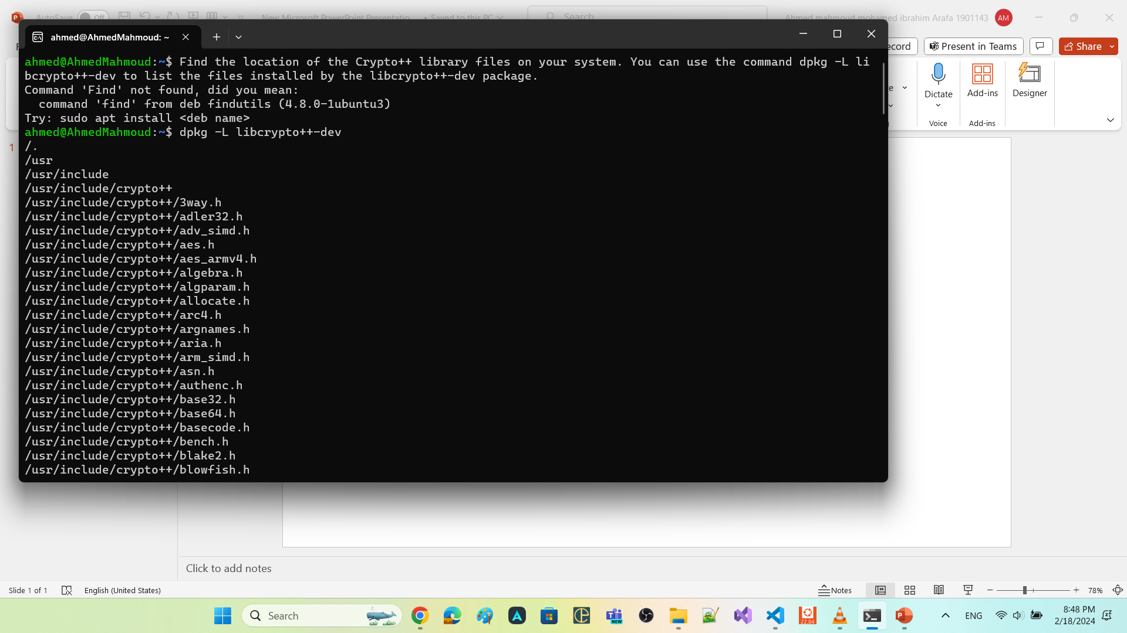

Continue: Crypto++ Library
dpkg -L libcrypto++-dev

Slide 6
Continue: Crypto++ Library
Include in CmakeLists.txt (soft way)
Create a FindCrypto++.cmake file with the following content:
find_path(Crypto++_INCLUDE_DIR cryptopp)
find_library(Crypto++_LIBRARY NAMES cryptopp)
set(Crypto++_FOUND TRUE)
if(NOT Crypto++_LIBRARY OR NOT Crypto++_INCLUDE_DIR)
set(Crypto++_FOUND FALSE)
endif()
if(Crypto++_FOUND)
set(Crypto++_LIBRARIES ${Crypto++_LIBRARY})
set(Crypto++_INCLUDE_DIRS ${Crypto++_INCLUDE_DIR}
endif()

Slide 7
Continue: Crypto++ Library
Update your CMakeLists.txt file with the following content:
cmake_minimum_required(VERSION 3.5)
project(Demo)
# Include the directory containing FindCrypto++.cmake
set(CMAKE_MODULE_PATH ${CMAKE_MODULE_PATH} ${CMAKE_CURRENT_SOURCE_DIR})
# Find the Crypto++ package
find_package(Crypto++ REQUIRED)
# Add your executable and link with Crypto++ library
add_executable(myExecutable main.cpp)
target_include_directories(myExecutable PUBLIC ${Crypto++_INCLUDE_DIRS})
target_link_libraries(myExecutable ${Crypto++_LIBRARIES})
Place the FindCrypto++.cmake file in the same directory as your CMakeLists.txt file

Slide 8
Security Concepts

Slide 9
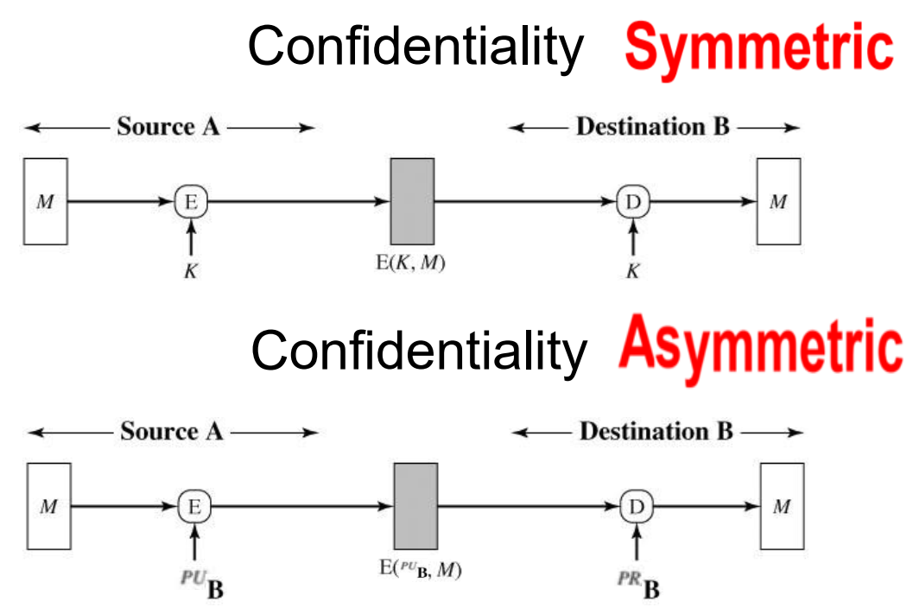
Security Concepts: Confidentiality
Use case
prevents unauthorized access to sensitive information.

Slide 10
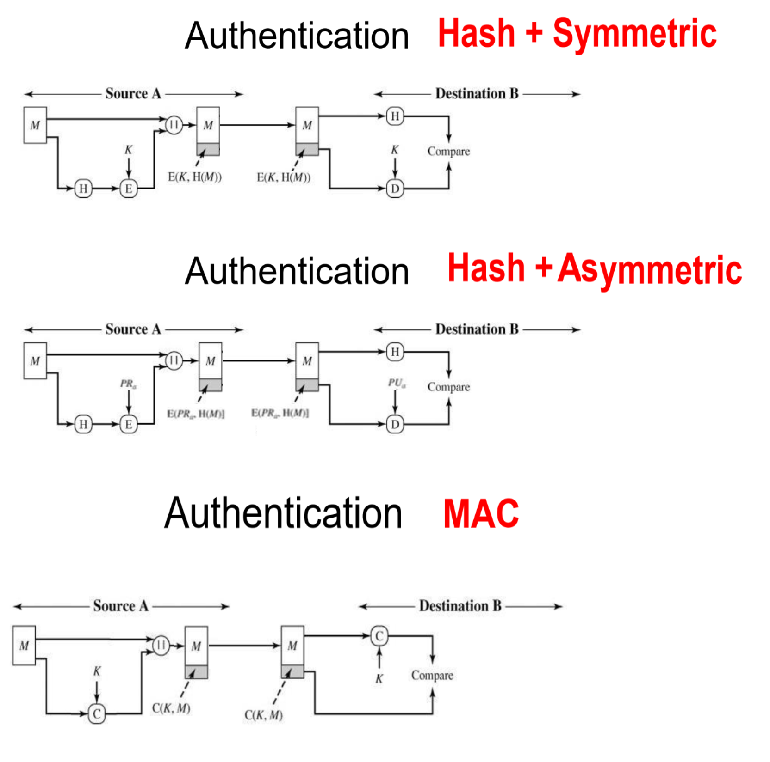
Security Concepts: Authentication
Use case at which we recommend authentication over encryption of plaintext
plaintext is large book
I want to ensure that no one edit it during transmission.
it is okay if anyone could read it

Slide 11
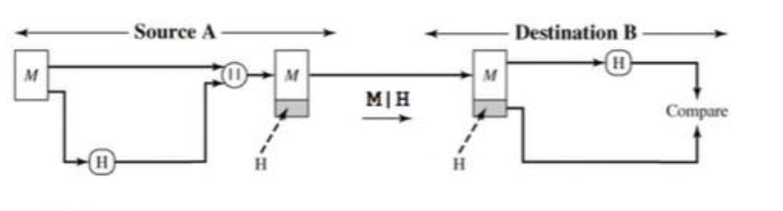
Security Concepts: Data Integrity Check
Use case
When we want to store data in the memory, and we want to sure that no one have modify this data

Slide 12
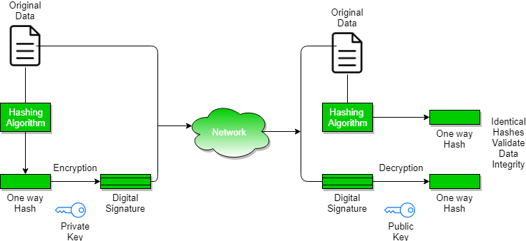
Security Concepts: Digital Signature

Slide 13
Overview

Slide 14
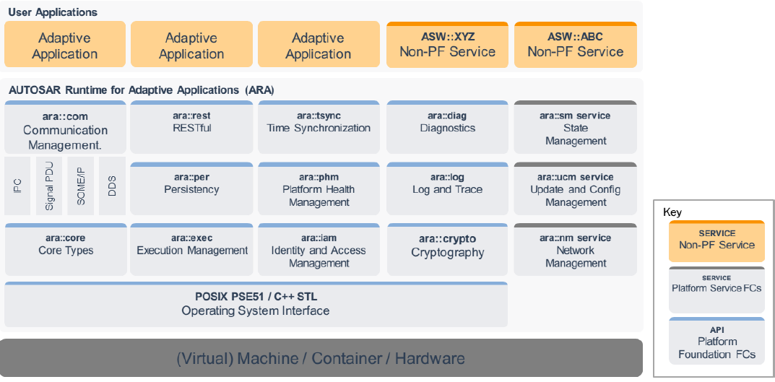
Overview
FC Crypto
foundation functional cluster.
offers applications and other Adaptive AUTOSAR Functional Cluster a standardized interface (CryptoAPI) for
access multiple implementations of cryptographic operations
key management
certificate handling.
supports
symmetric-key cryptography.
both public-key cryptography

Slide 15
Continue: Overview
CryptoAPI provides a set of methods which enable application and system developer to
store and transmit information while safeguarding it from intruders.
keep critical information in confidential and / or authentic form
communicate in a way such that only the intended recipient can read the message
FC Crypto
provides mechanisms for applications that ensure the following security goals:
Authentication: FC Crypto provides mechanisms that allow adaptive applications or functional clusters to prove their identity to other applications or functional clusters.
Non-Repudiation: FC Crypto supports the concept of non-repudiation, where someone cannot deny the validity of something.
Confidentiality: FC Crypto allows to keep information private. encryption can assure that only users who have access to the appropriate key will get read access to the data plaintext.
Integrity: FC Crypto ensures that secured data is not altered during storage or transmission without the receiver detecting this altering.

Slide 16
Continue: Overview
The FC Crypto
mediates for Adaptive Application and Functional Cluster access and usage of secret key material
The Adaptive Application and Functional Cluster should not have direct access to keys within its own process.
verifies whether an application or functional cluster is allowed to access a specific cryptographic object, which is stored in the infrastructure of the FC Crypto.
This access control mechanism is realized in combination with IAM, where the FC Crypto acts as a policy enforcement point.

Slide 17
Crypto API

Slide 18
Crypto API
Crypto Api is divided into the following sub-parts:
Key Storage Provider.
One or more Crypto Provider
X.509 Certificate Management Provider
each of provider implements specific domain of cryptography-related functionality

Slide 19
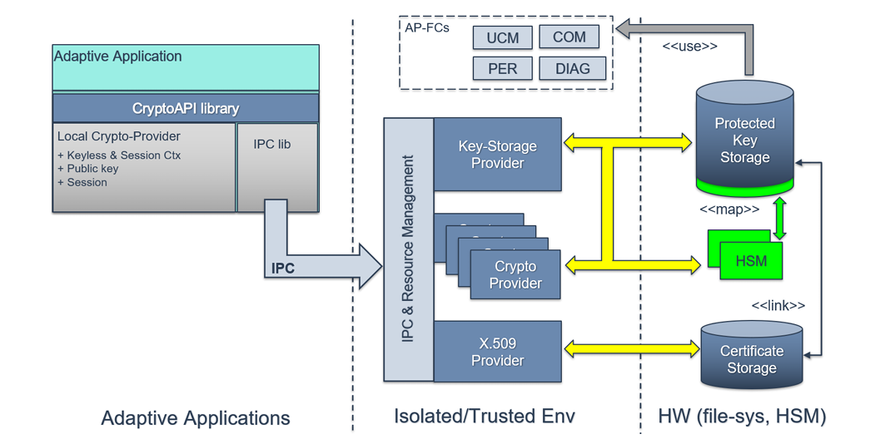
Continue: Crypto API

Slide 20
Continue: Crypto API
CryptoAPI provided by FC Crypto to consumers is presented by three different Provider types, each of them implements specific domain of cryptography-related functionality:
1. Crypto Provider (CP, namespace ara::crypto::cryp)
responsible for implementation of all supported cryptographic primitives.
FC Crypto may support multiple instances of the CryptoProviders.
Each instance of CryptoProvider represents single holistic software- or hardware-based implementation of some set of cryptographic algorithms.
2. Key Storage Provider (KSP, namespace ara::crypto::keys)
responsible for secure (confidential and/or authentic) storage of different type key material (public/private/secret keys, seeds) and other security critical cryptographic objects (digital signatures, hash, MAC/HMAC tags).
CryptoAPI consumers work with logically single KSP that is used for access to all crypto objects

Slide 21
Defined interfaces

Slide 22
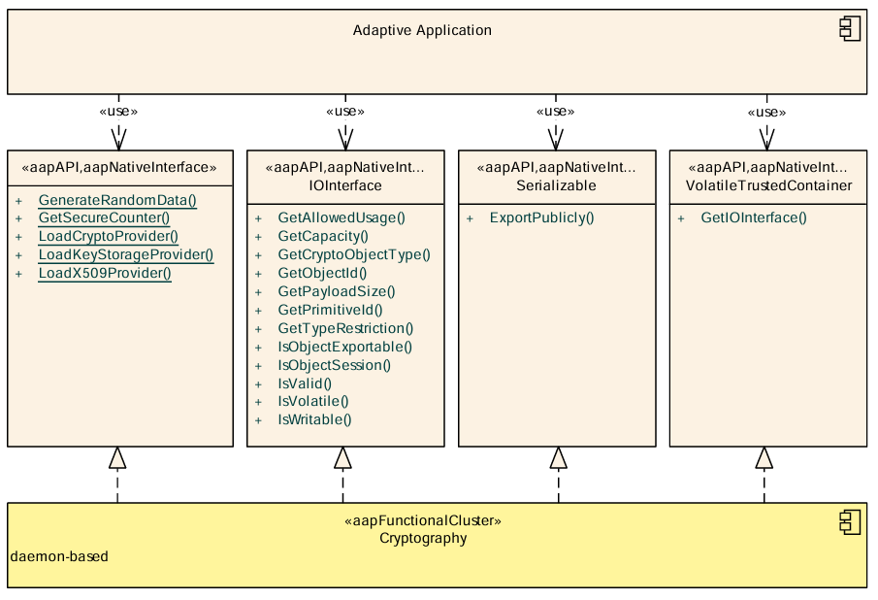
Defined interfaces
The main entry point for using the CrypoAPI is the factory functions
Load CryptoProvider()
for using cryptographic routines
LoadKeyStorageProvider()
for access to the key store
LoadX509Provider()
for X.509 certificate handling.

Slide 23
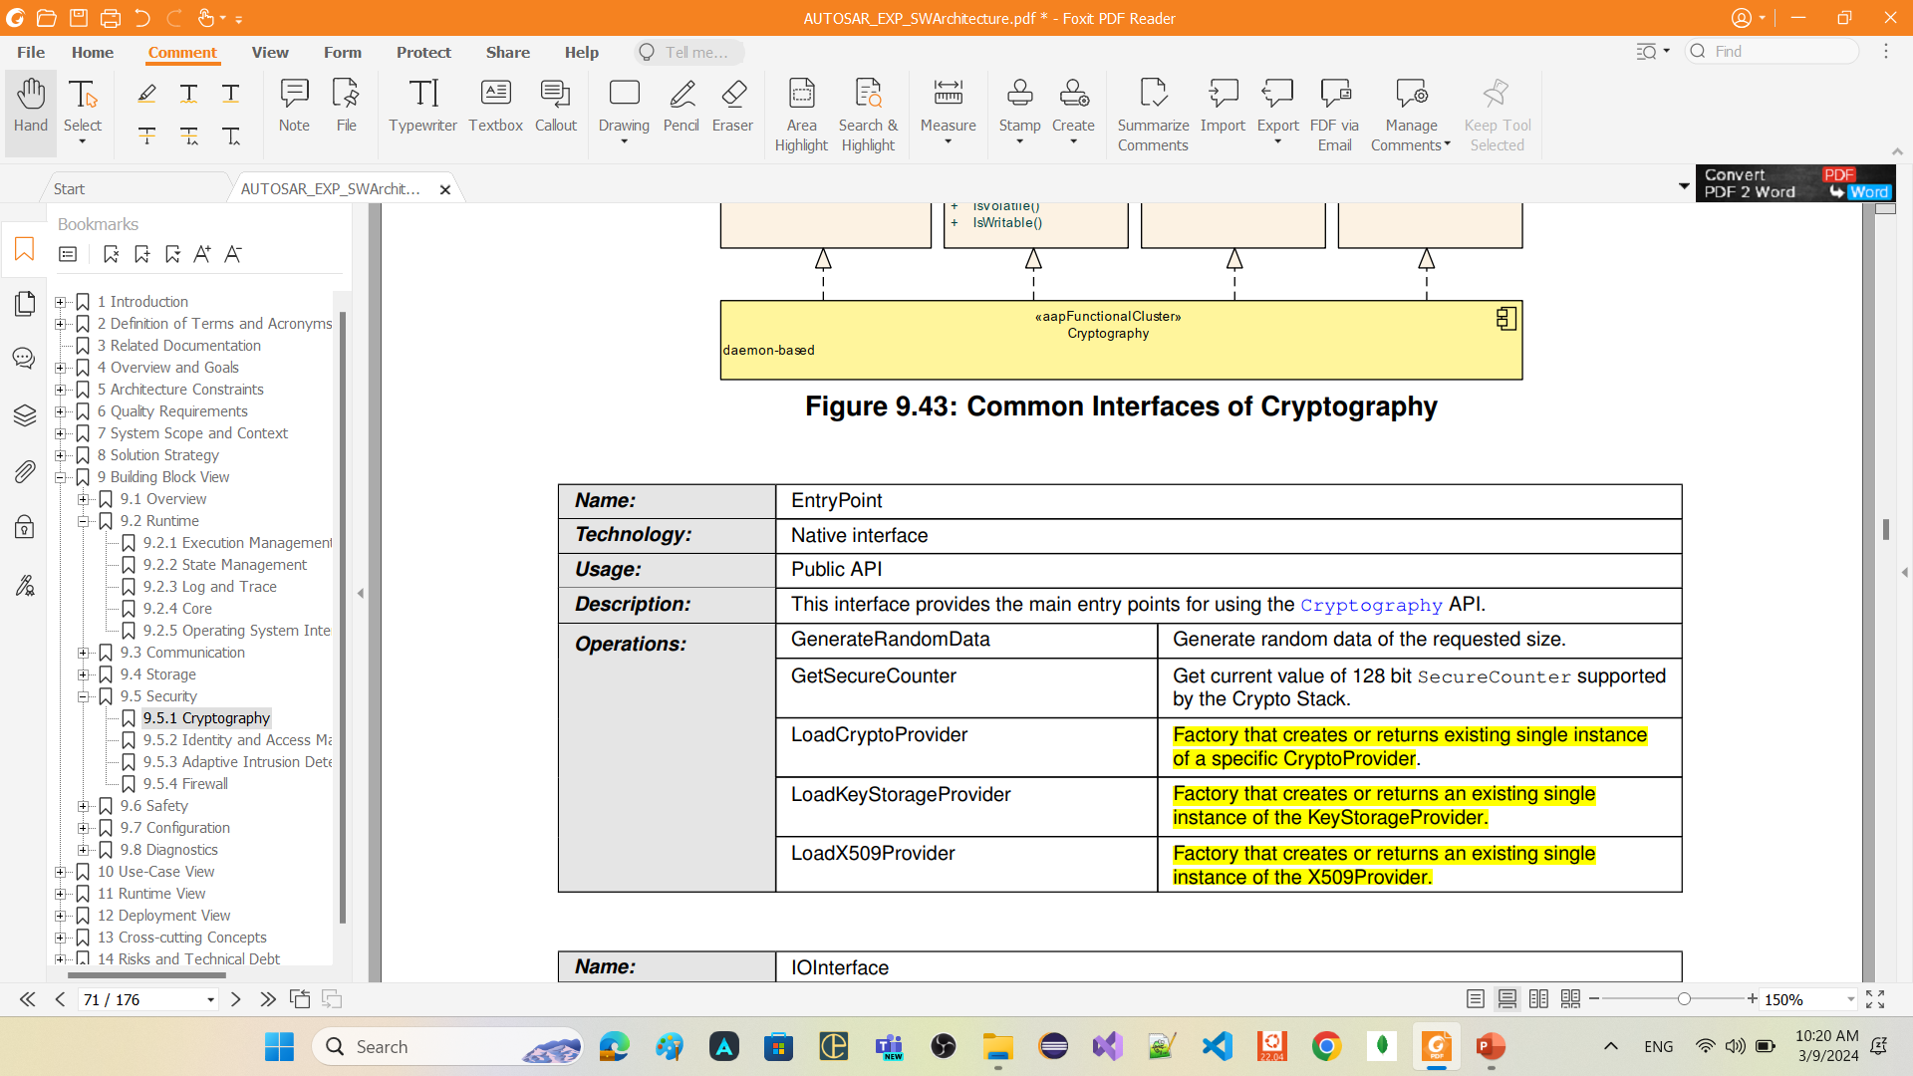
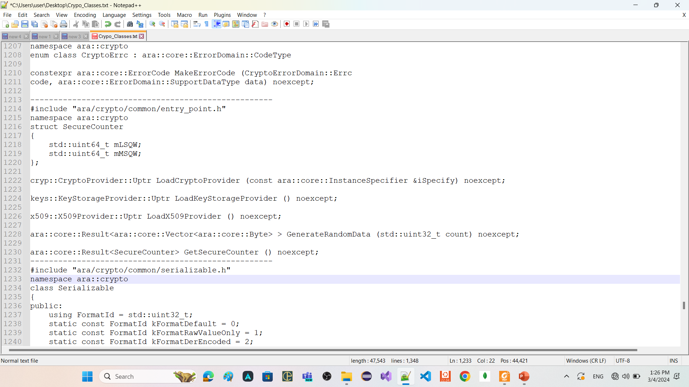
Defined interfaces: EntryPoint

Slide 24
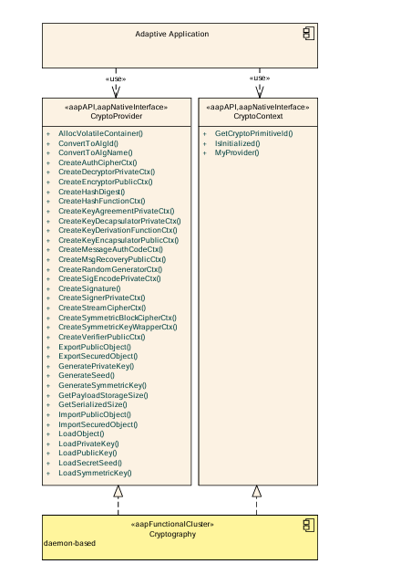
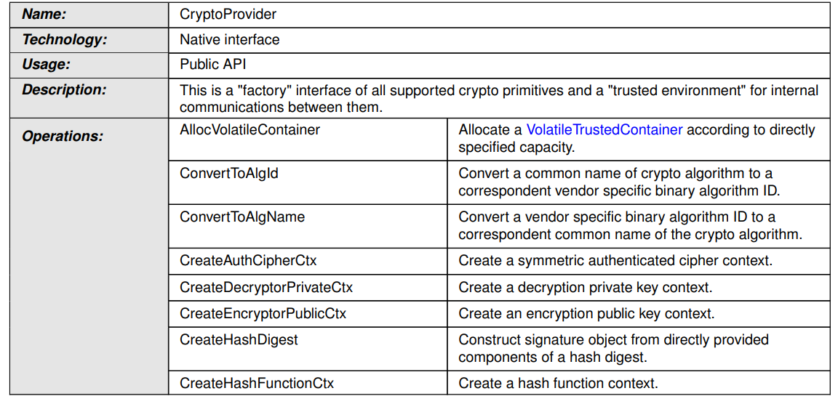
Defined interfaces: CryptoProvider
The CryptoProvider interface provides access to various cryptographic routines. Each of those routines is managed by specializations of the CryptoContext interface.
CryptoProvider has table storing (ids/names) of algorithms it supports

Slide 25

Defined interfaces: CryptoProvider cont.

Slide 26

Defined interfaces: CryptoProvider cont.

Slide 27
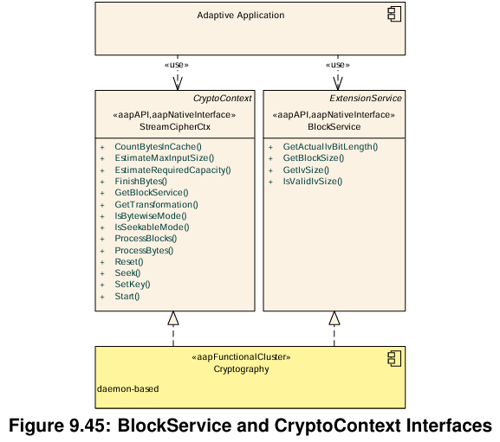
Defined interfaces: contexts

Slide 28
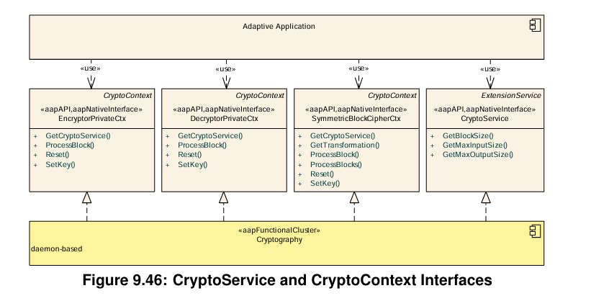
Defined interfaces: contexts cont.

Slide 29
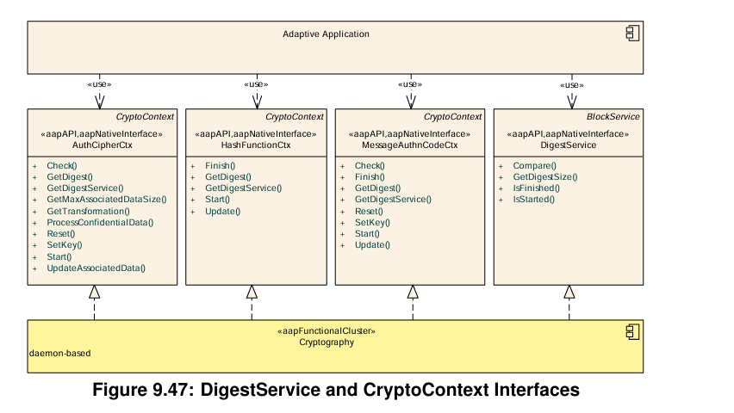
Defined interfaces: contexts cont.

Slide 30
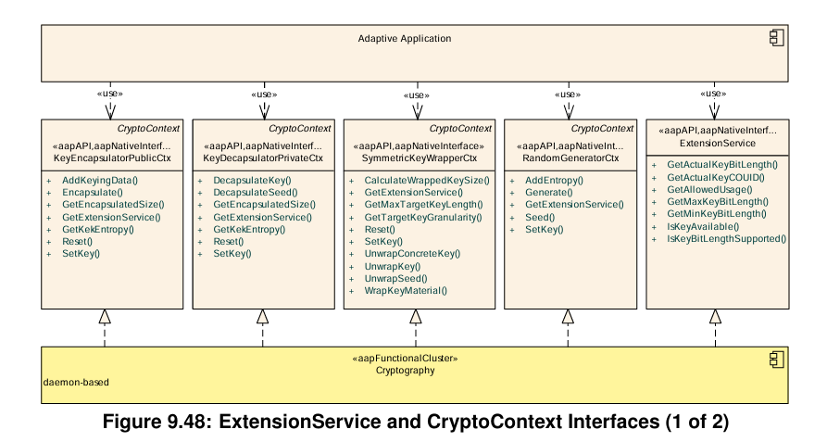
Defined interfaces: contexts cont.

Slide 31
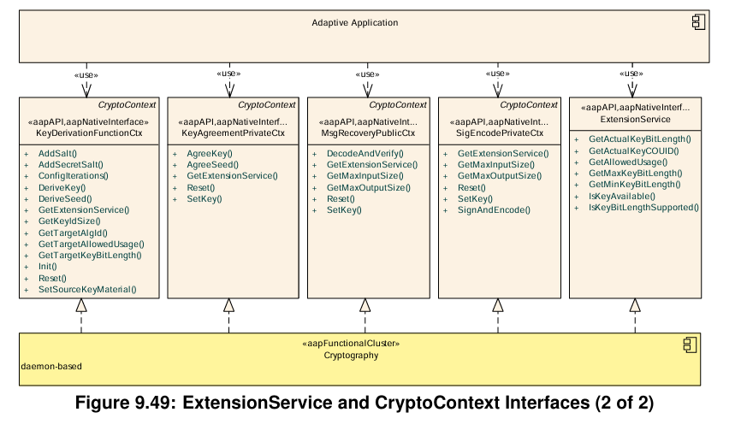
Defined interfaces: contexts cont.

Slide 32
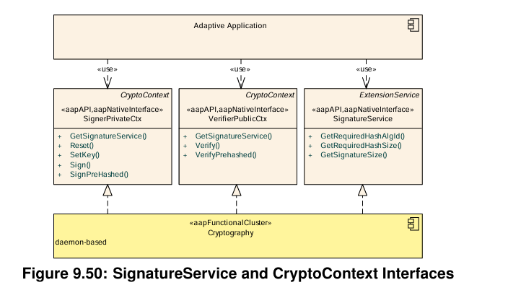
Defined interfaces: contexts cont.

Slide 33
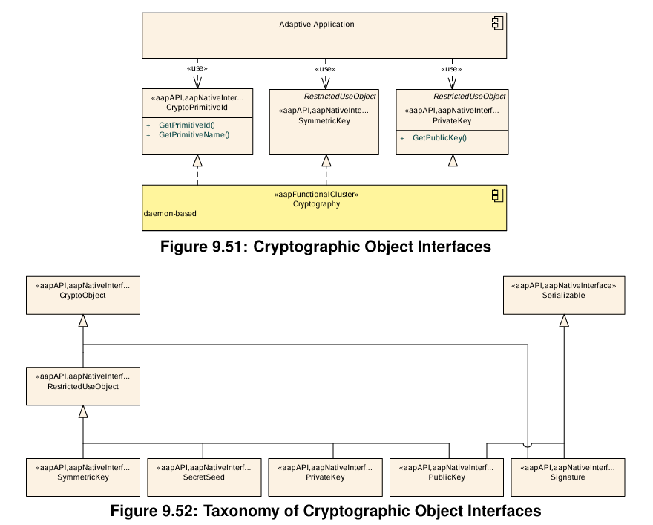
Defined interfaces: Cryptographic object

Slide 34
Crypto Provider

Slide 35
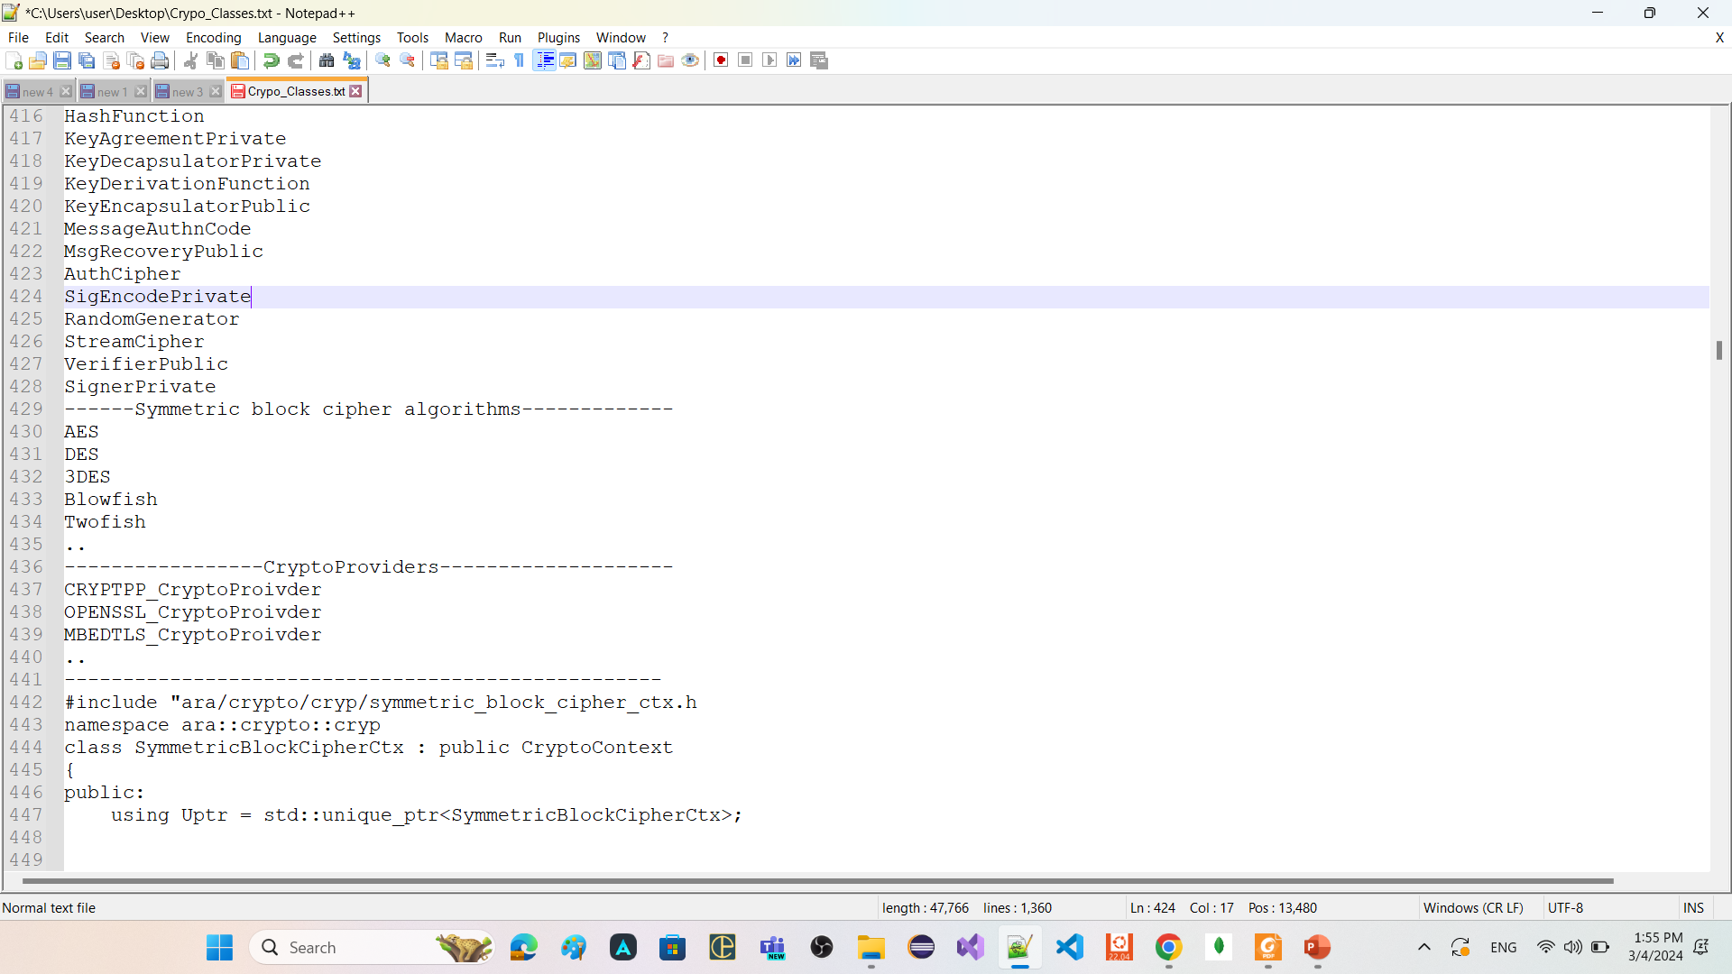
Crypto Provider
FC Crypto allow to use software libraries like
Crypto++
Openssl
Mbedtls
…
Crypto Provider standardize the APIs that should be use to preform cryptographic operations
Crypto Provider is a structural element that organizes cryptographic primitives (algorithms).
Every Crypto Provider instance represents exactly a cryptographic library.
at least one Crypto Provider for software element that is available in a project specific environment

Slide 36
Continue: Crypto Provider
Crypto Provider class == CryptoProviderFactory (global factory method)
doesn't have constructor inside its public scope
Any instance of it can be used to preform cryptographic operations
CyptoPP_CryptoProvider or OpenSLL_CryptoProvider or Mbedtls_CryptoProvider also doesnot have constructor inside their public scope
CryptoProvider
CyptoPP_CryptoProvider
OpenSLL_CryptoProvider
Mbedtls_CryptoProvider

Slide 37
Crypto Object

Slide 38
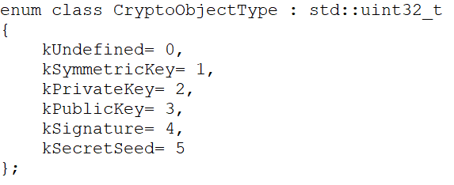
Crypto Object

Slide 39
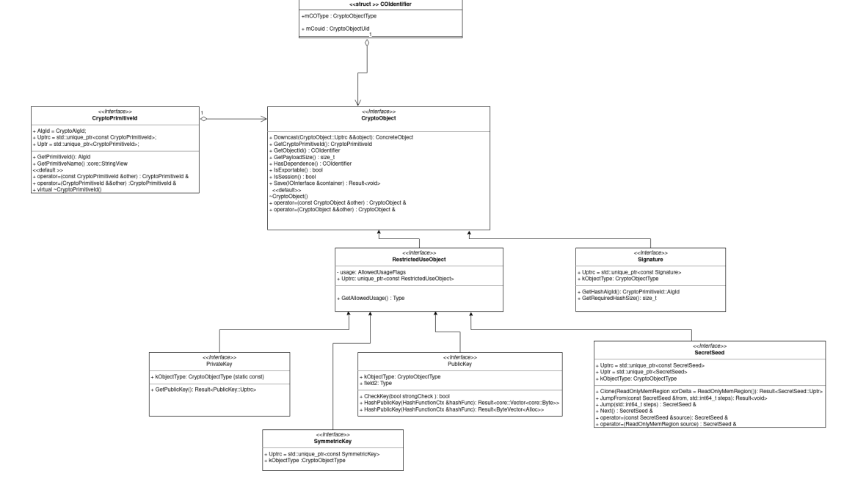
Continue: Crypto Object

Slide 40
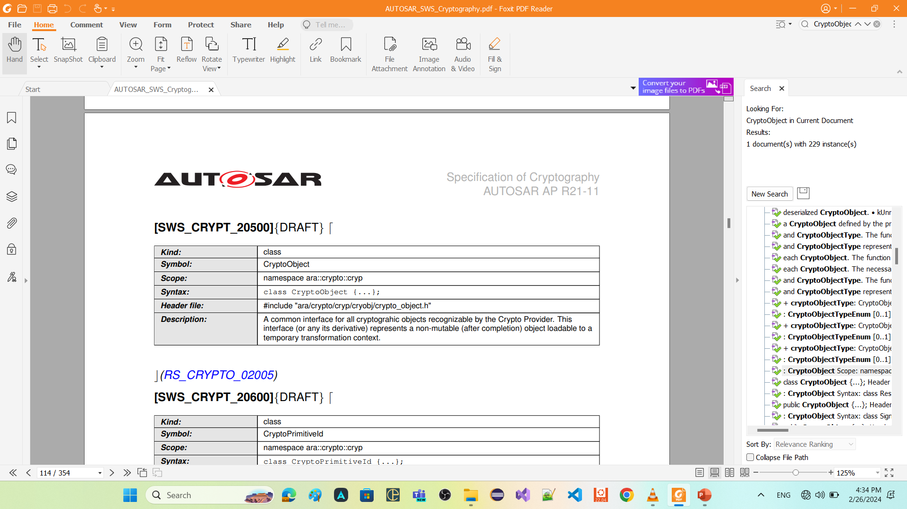

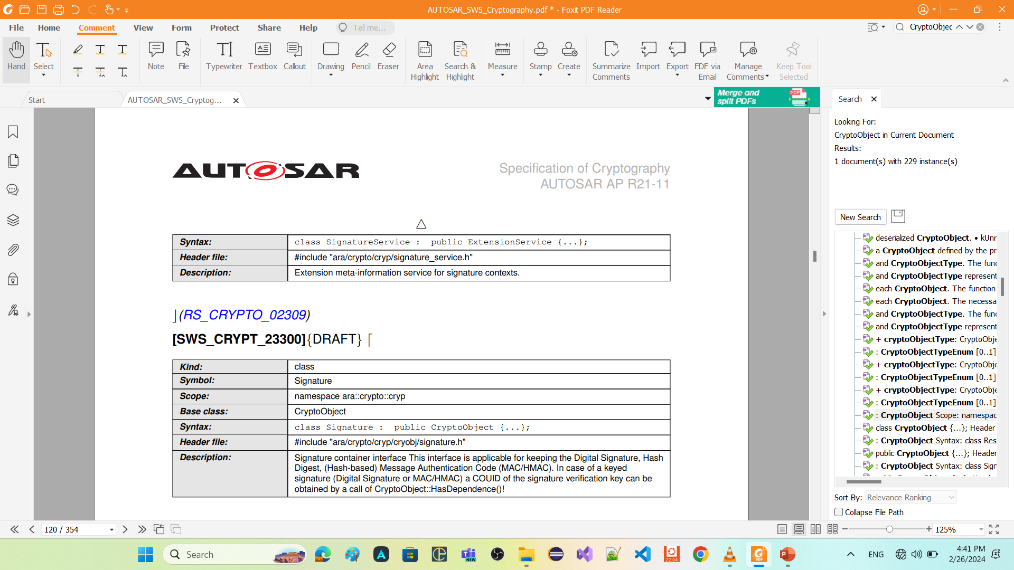
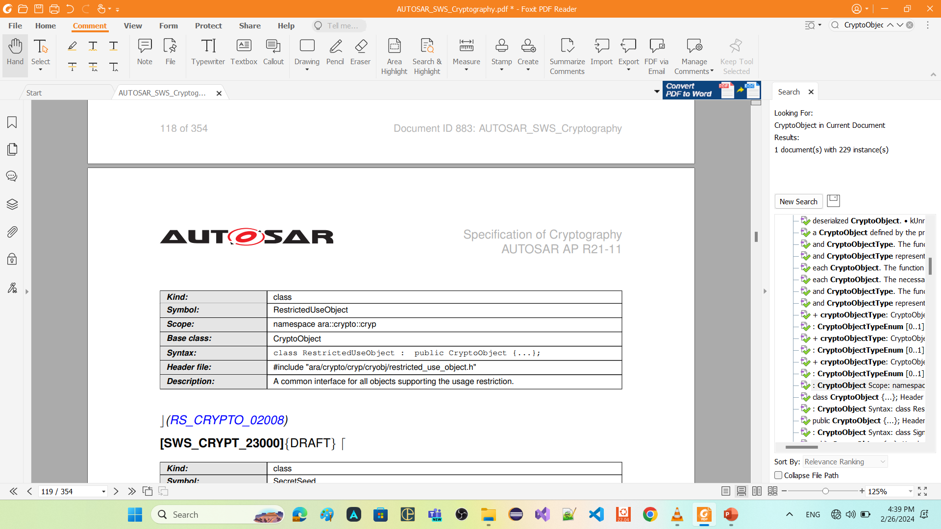
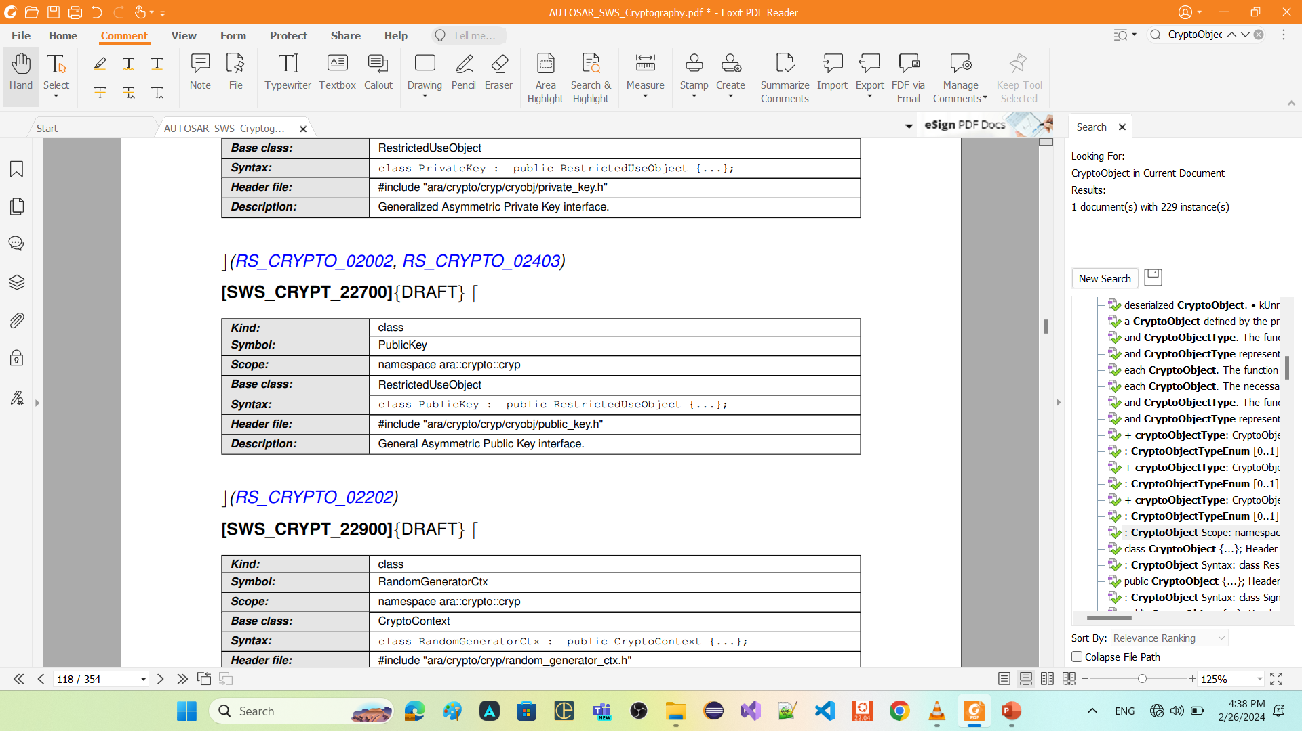
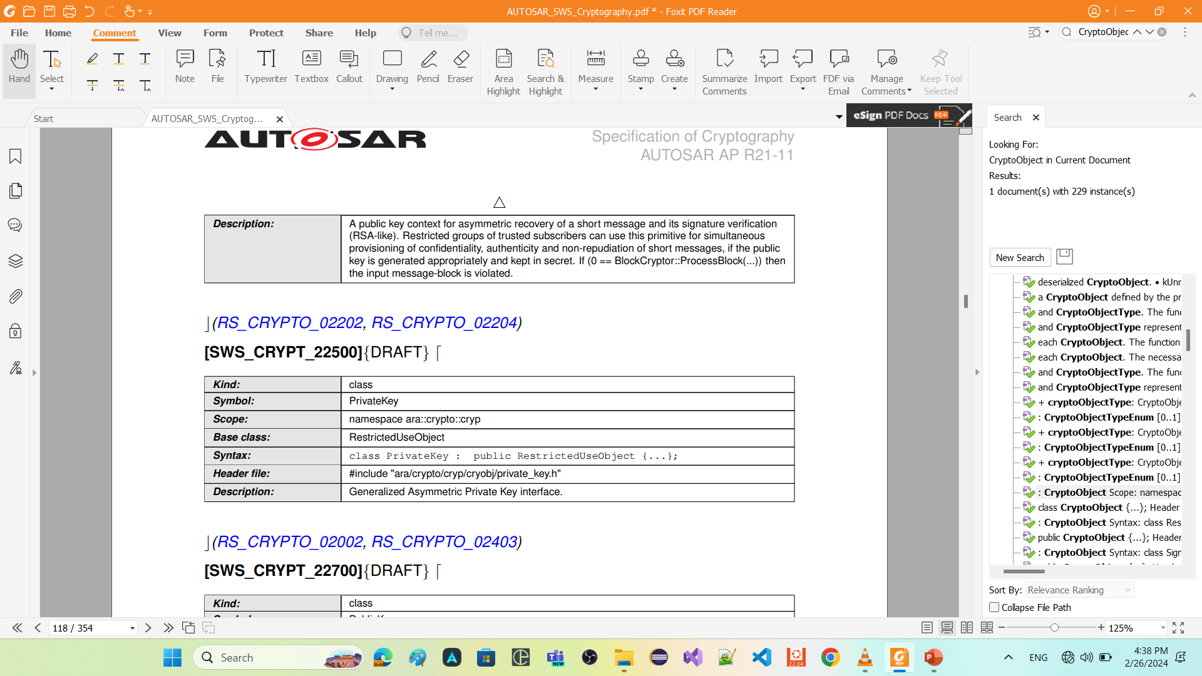
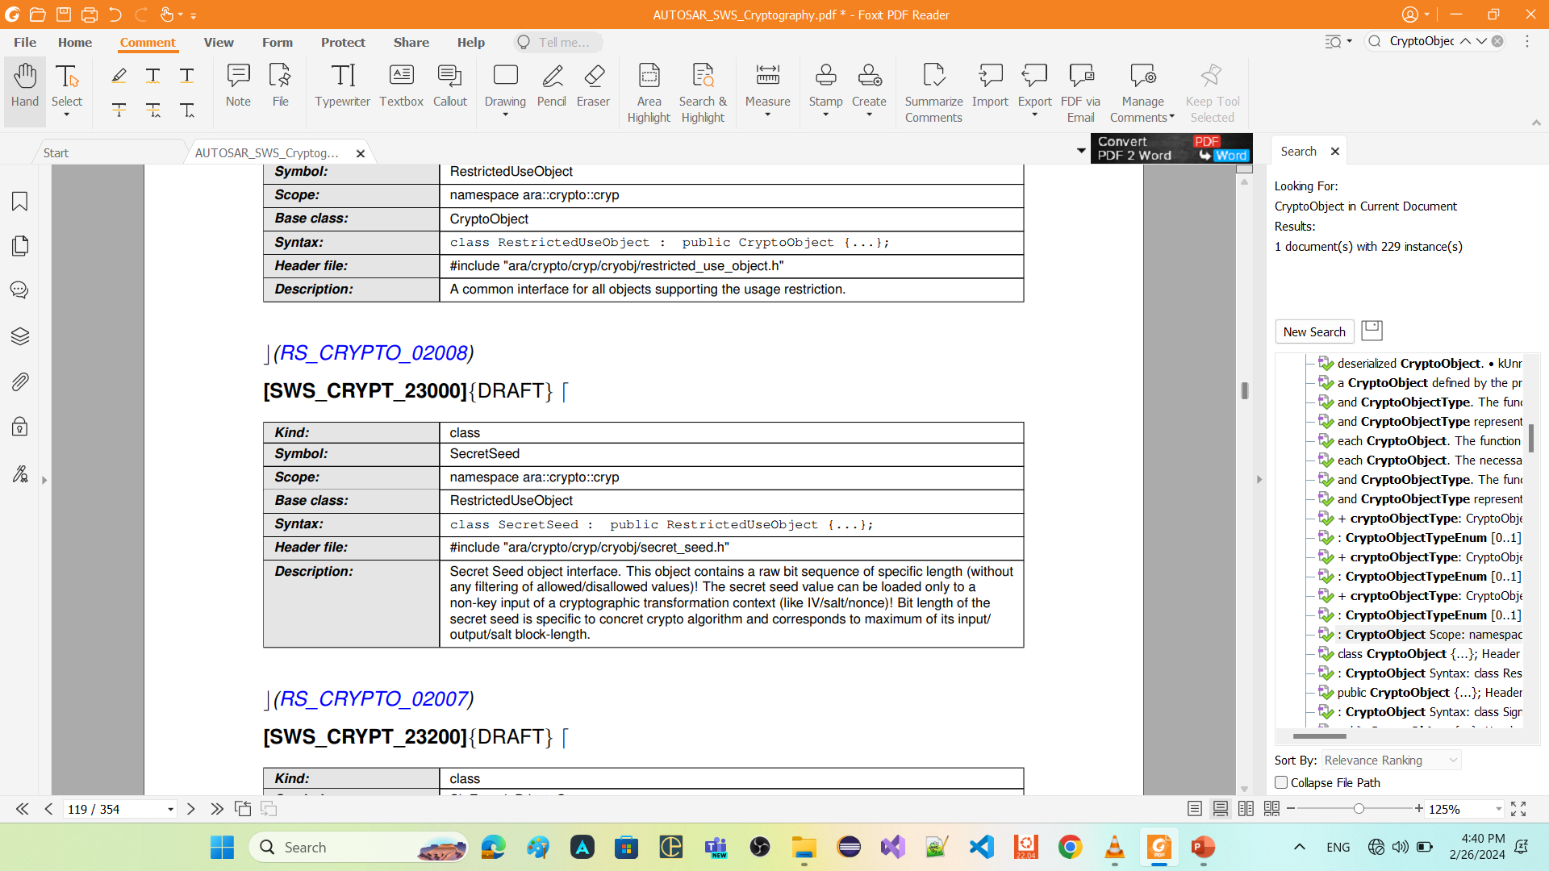
Continue: Crypto Object

Slide 41
IO Interface

Slide 42
IO Interface
One major design decision of FC Crypto is to separate to the extent possible the three domains dealing with cryptography (crypto::cryp), key management (crypto::keys) and certificate management (crypto::x509). To simplify interaction between domains and abstract interfaces from the actual object the IO Interface interface has been introduced as an intermediate layer between the persistent resource and the runtime object. The IO Interface represents a smart wrapper providing access to and meta-data on the content it is encapsulating. For example, it can be used by an application to instantiate a runtime crypto-object from its persistent storage location (read-access). Or it can be used by an application to store a runtime crypto-object into a persistent storage location (write-access).

Slide 43
Continue: IO Interface
Volatile trusted container As discussed above, we can use volatile memory for the io operations, thus, the VolatileTrustedContainer is used as a container for crypto objects to be stored in a volatile memory It can be used as an alternative to working with the keyProvider but of course it doesn’t provide persistent storage of keys

Slide 44
Contexts

Slide 45
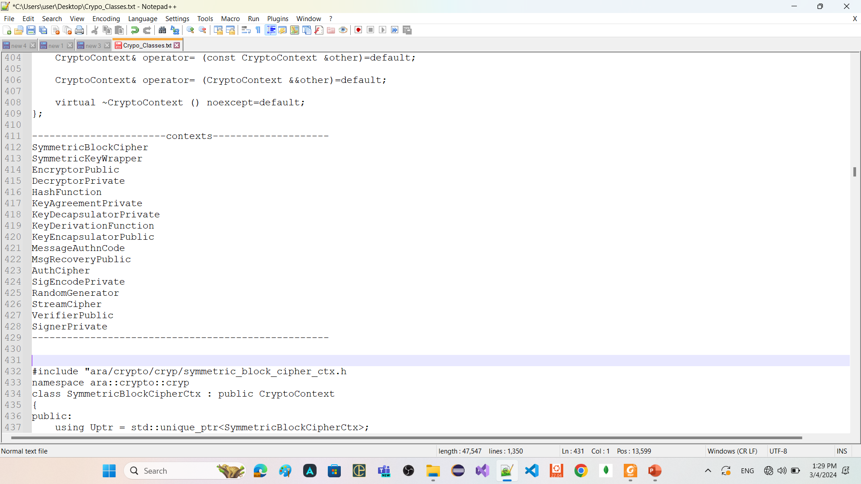
Contexts
context refers to a data structure or object that encapsulates the state and parameters required for a specific cryptographic operation.

Slide 46
Continue: Contexts
Key1
Key2
DES
AES
RSA
ECDSA
Key3
Key4
Sha-256
context
Sha-512
context
DES
Sha-3
context
context
AES
RSA
context
context
Sha-256
CryptoProvider

Slide 47
SymmetricBlockCipherCtx
implement symmetric block cipher algorithms

Slide 48
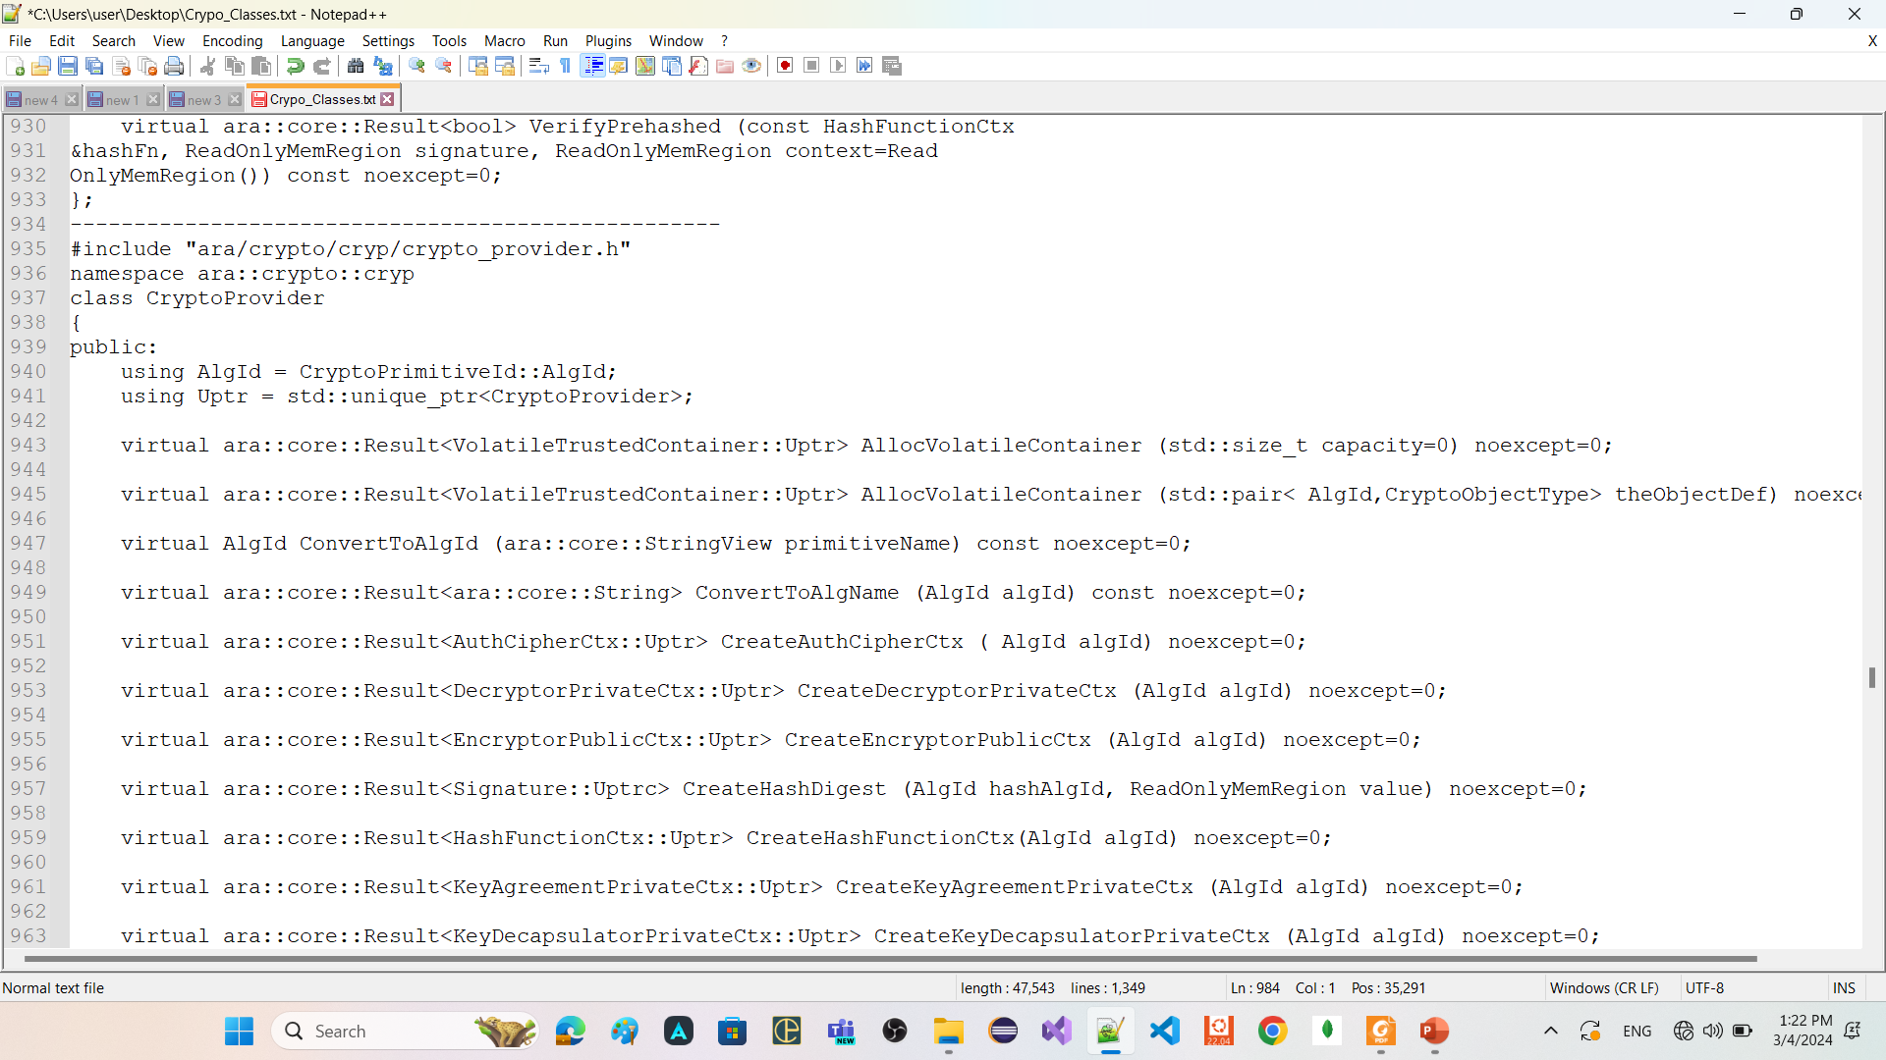
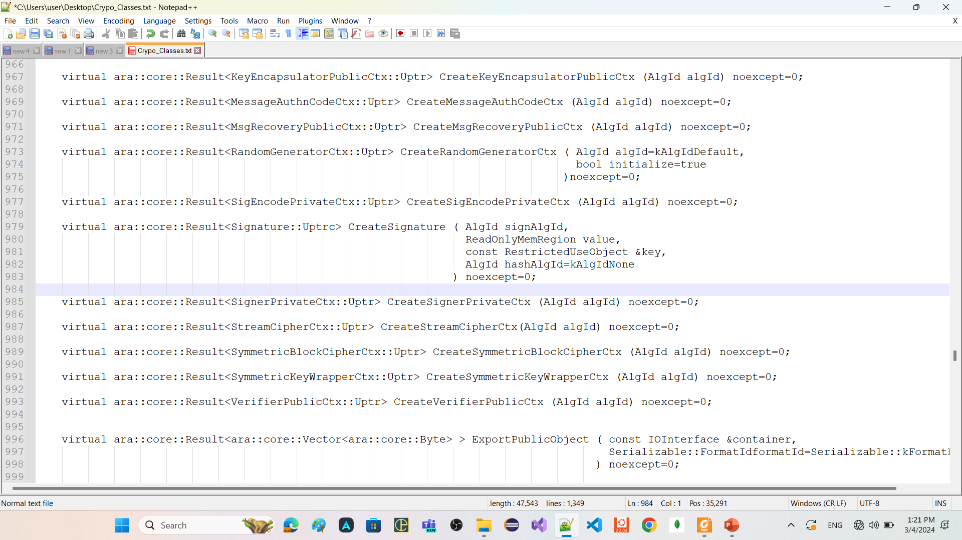
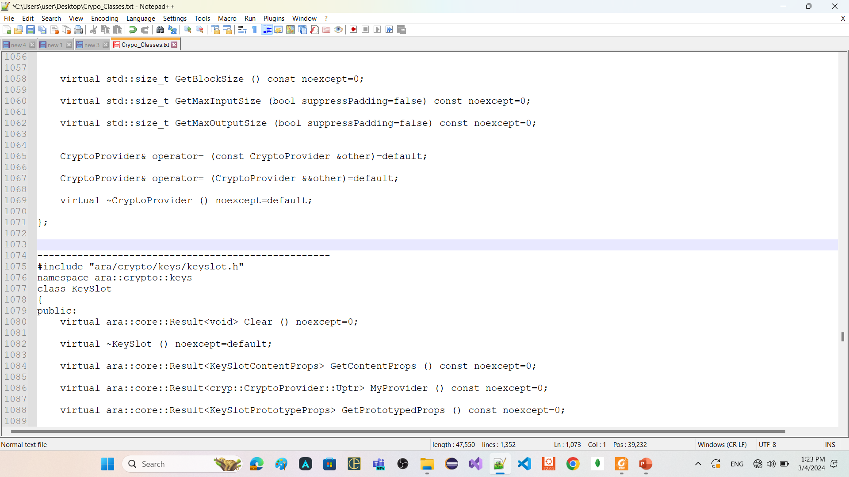
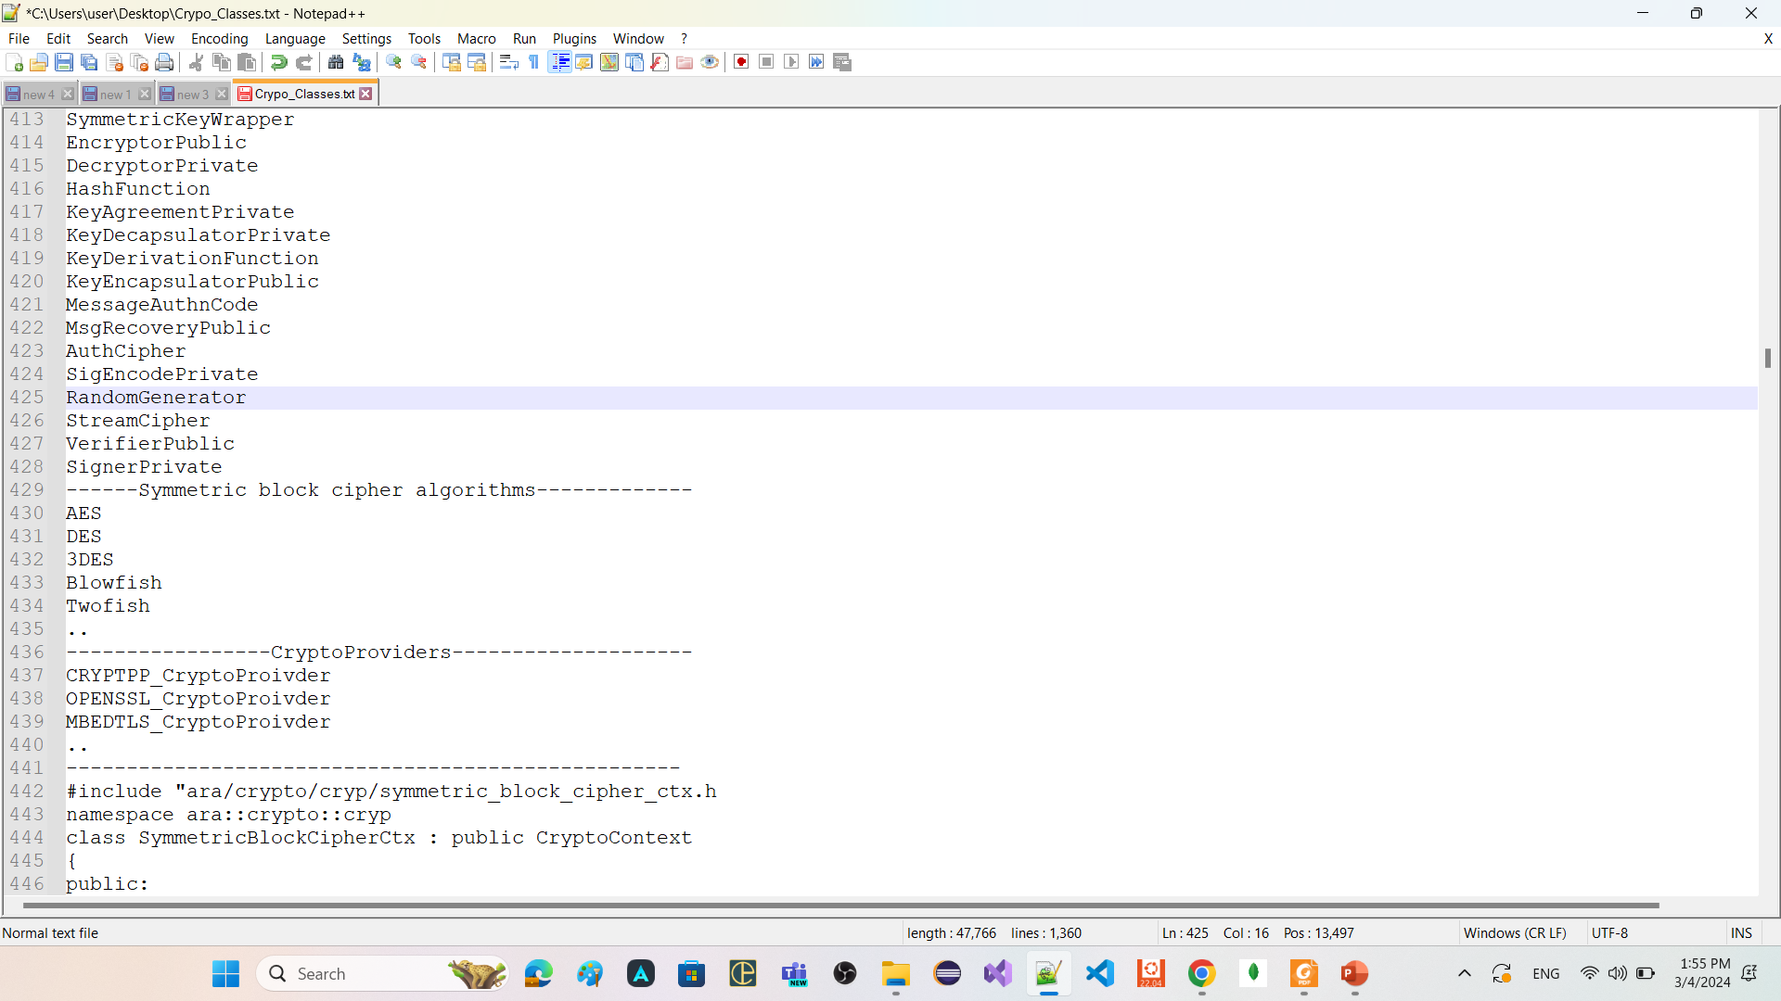
SymmetricBlockCipherCtx

Slide 49

Continue: SymmetricBlockCipherCtx

Slide 50
Continue: SymmetricBlockCipherCtx
SymmetricBlockCipherCtx:
is related only one algorithm of Symmetric block cipher algorithms
has member functions
SetKey
Takes object of class CryptoTransform
To configure this context is for encryption or decryption
Takes object of class SymmetricKey
GetTransformation
return the CryptoTransform that was provided in the last valid call to SetKey.
GetCryptoService
return a unique pointer to CryptoService associated with this context.
ProcessBlock
apply the configured transformation (encryption or decryption) to the provided ReadOnlyMemRegion (container of elements) (span) and return the result.

Slide 51

Continue: SymmetricBlockCipherCtx

Slide 52
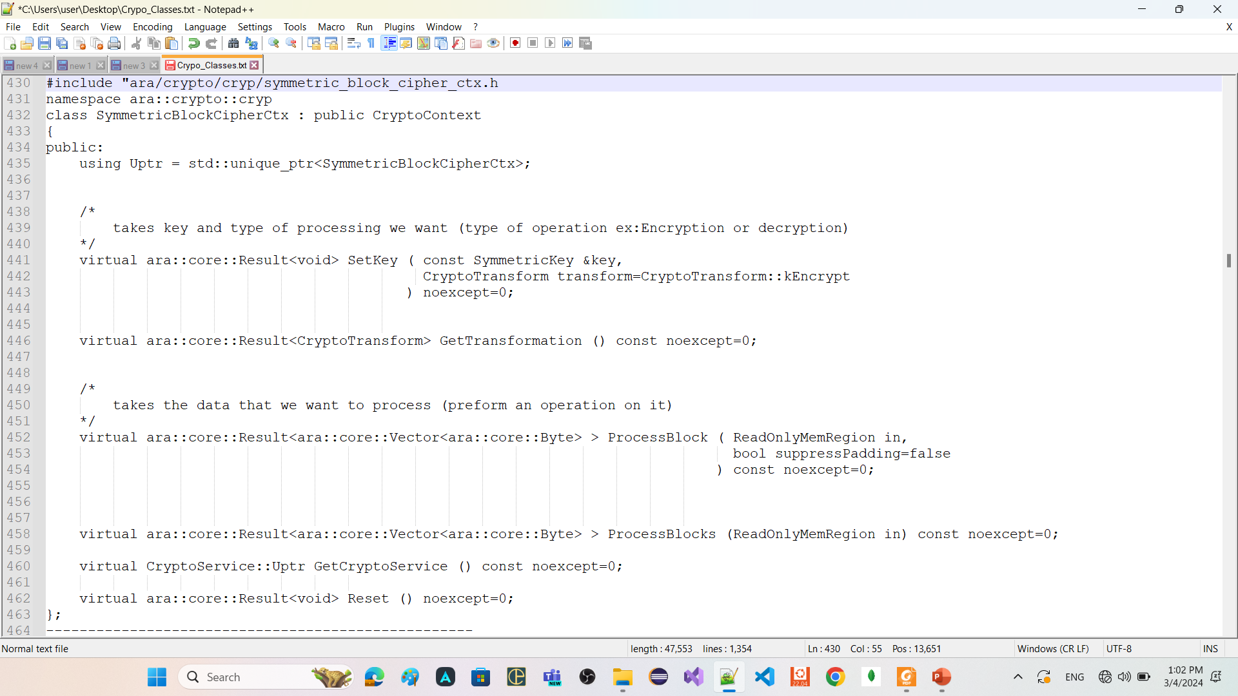
Continue: SymmetricBlockCipherCtx

Slide 53
Continue: SymmetricBlockCipherCtx
Load Key
4
1
Set key, operation
5
2
Process operation
6
3

Slide 54
HashingFunctionCtx
implement hashing algorithms

Slide 55
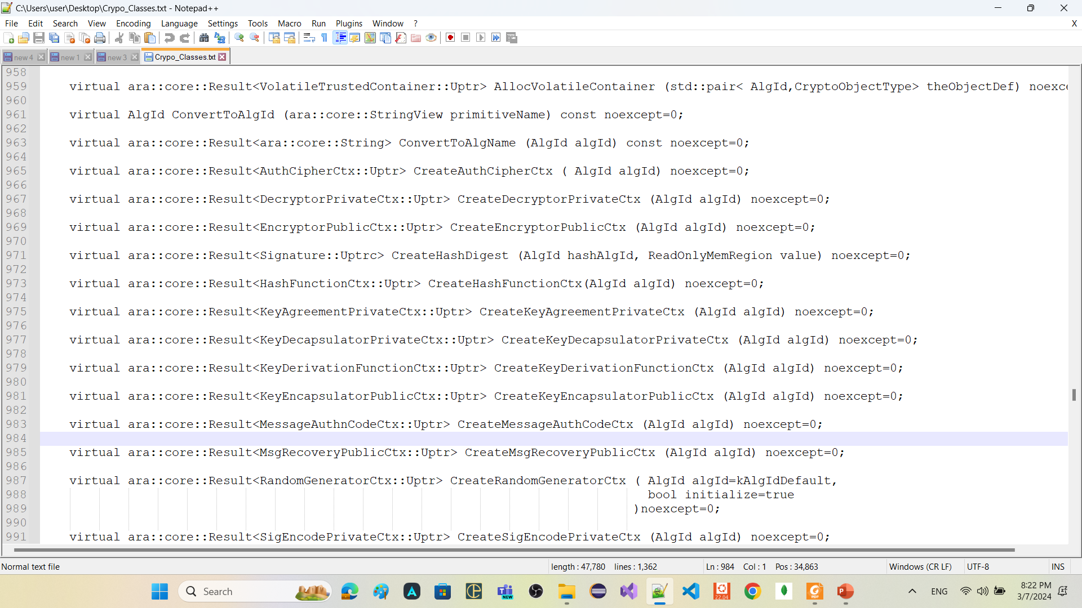
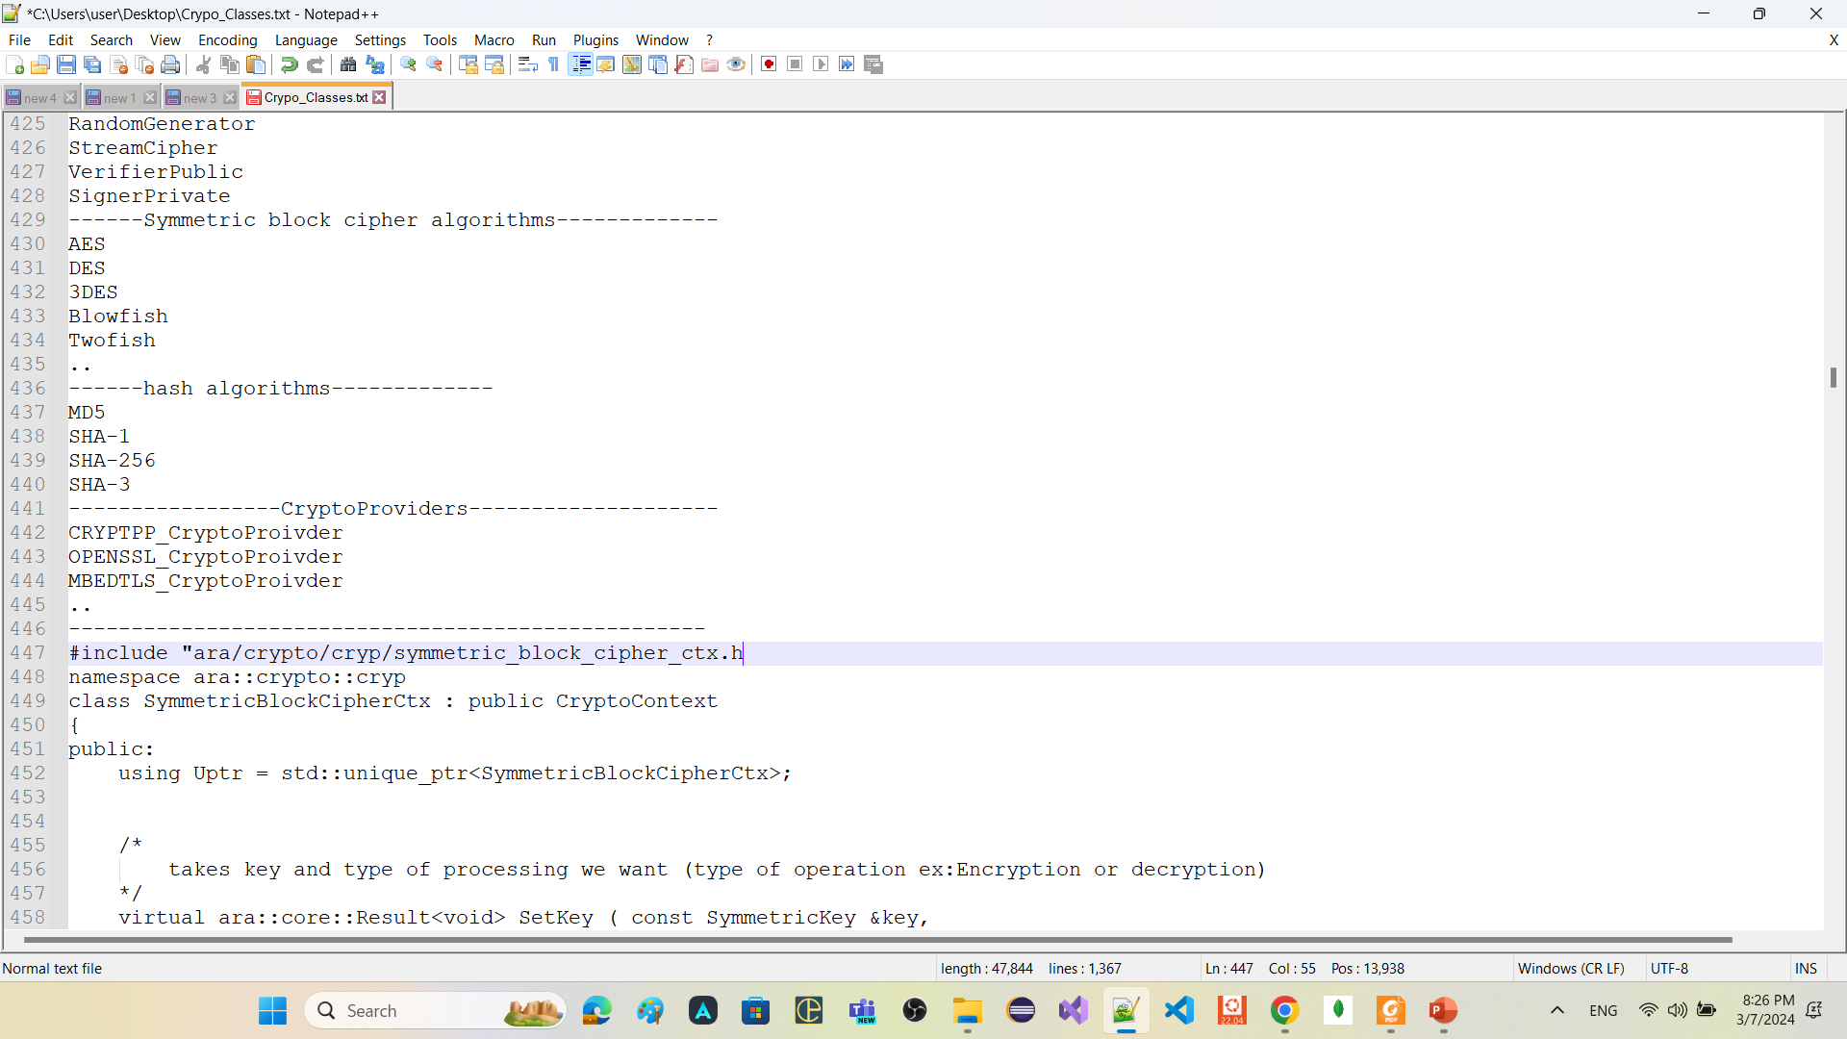
HashingFunctionCtx

Slide 56
Continue: HashingFunctionCtx
Remember
A hash-function a one-way function and maps an arbitrary string of bits to a fixedlength string of bits (Its result is practical infeasible to invert).
HashFunctionCtx
Its object is related only one algorithm of hashing algorithms
store the calculated hash value until this HashFunctionCtx object is destroyed or the function Start is called again.
has member functions
Start
Functionality
clear the current hash value and initialize the context with the provided IV
prototype
ara::core::Result<void> Start ();
ara::core::Result<void> Start (ReadOnlyMemRegion iv);
returns
kInvalidInputSize, if the size of the provided IV is not supported by the configured context AlgId.
kUnsupported, If the configured context AlgId does not support an IV.
kMissingArgument, if the configured context AlgId expected an IV but none was provided
Notes
Start can be called after Update. In this case the HashFunctionCtx will not return an error, instead Start will start a new hash value calculation.

Slide 57
Continue: HashingFunctionCtx
Update
Functionality
implement hash algorithm calculation.
Prototype
ara::core::Result<void> Update (ReadOnlyMemRegion in);
returns
CryptoErrorDomain::kProcessingNotStarted error, if Start has not been called before
Notes
The user application shall be able to call Update multiple times, each time providing a new chunk of data. Update shall update the hash value calculation with each new chunk.
Finish
Functionality
finalize the hash value calculation and return the hash value
prototype
virtual ara::core::Result<ara::core::Vector<ara::core::Byte> > Finish () noexcept=0;
returns
CryptoErrorDomain::kProcessingNotStarted error, if Start has not been successfully called before.
CryptoErrorDomain::kInvalidUsageOrder error, if Update has not been called successfully after the last call to Start.
Notes
If Finish is called multiple times for the same hash value calculation, then only the first call shall apply the finalizations step; i.e. all other subsequent calls shall only return the hash value.

Slide 58
Continue: HashingFunctionCtx
getDigest
Functionality
return the finalized hash value
Prototype
ara::core::Result<ara::core::Vector<ara::core::Byte> > GetDigest (std::size_t offset=0);
returns
kProcessingNotStarted error, if Finish has not been called for the current hash value calculation
Start
Update
Finish
getDigest

Slide 59
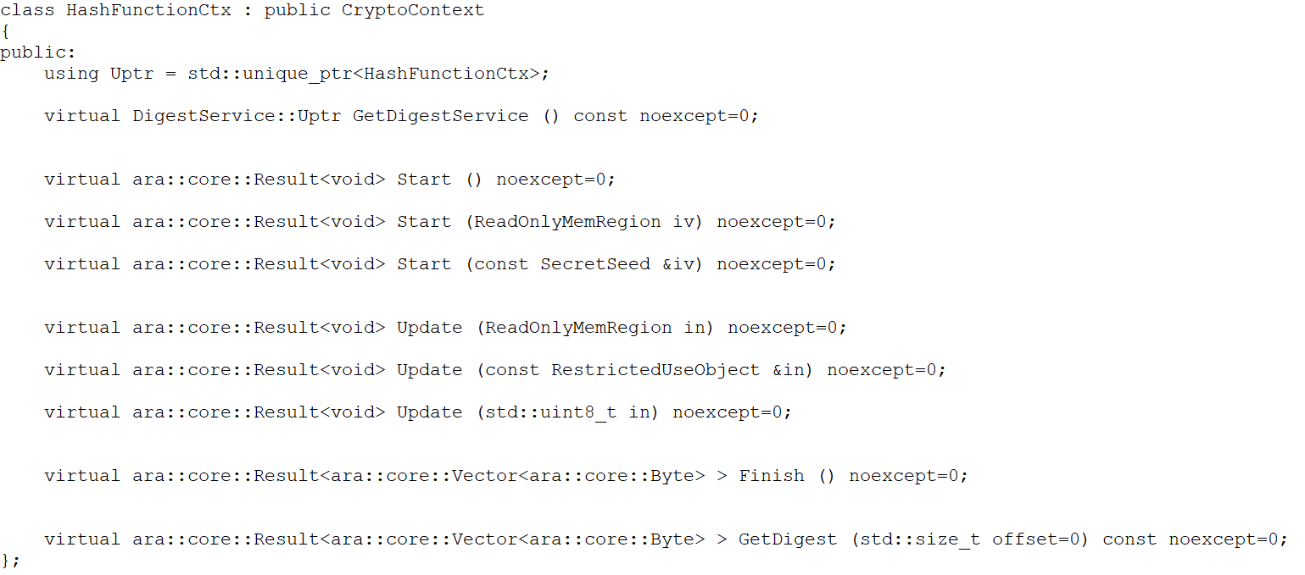
Continue: HashingFunctionCtx

Slide 60
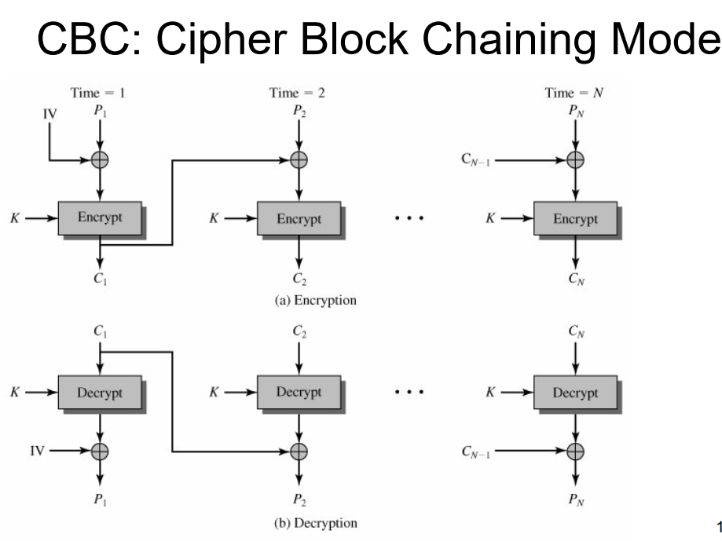
Continue: HashingFunctionCtx
the initialization vector (IV) is not commonly used in the context of hashing algorithms like SHA256, it is commonly used in other cryptographic operations, such as symmetric encryption algorithms like AES (Advanced Encryption Standard) in CBC (Cipher Block Chaining) mode.
In CBC mode, each plaintext block is first XORed with the previous ciphertext block before encryption. To ensure the uniqueness and randomness of the XOR operation, an IV is used as the previous ciphertext block for the first block. The IV is typically a random or pseudorandom value that is known to both the sender and the receiver.
Here's an example of how an IV can be used in hashing when combined with a symmetric encryption algorithm like AES in CBC mode:

Slide 61
RandomNumberGeneratorCtx

Slide 62
RandomNumberGeneratorCtx
RandomNumberGeneratorCtx:
Generating randomness or pseudo randomness is required for many operations such as creating Salts (RNG for passwords) or Nonces (RNG for cryptographic topics).
In order to enable applications to perform these operations, CryptoAPI provides an interface to generate random data.
The RNG context is used to generate a sequence of random numbers that appear unpredictable and non-repeating.
"entropy" refers to the amount of randomness or unpredictability present in a given set of data. A high-entropy source of data is one that is very difficult to predict or reproduce, making it ideal for use as a source of randomness for cryptographic purposes.
A "seed" is a piece of data used to initialize a random number generator. The seed is typically a fixed-length string of bytes that is used to set the initial state of the RNG’s internal state machine.
A high-entropy seed ensures that the sequence of numbers generated by the random number generator is unpredictable and difficult to reproduce.

Slide 63
Continue: RandomNumberGeneratorCtx
has member functions:
Generate
Return an allocated buffer with a generated random sequence of the requested size.
SecByteBlock: A class used to store byte arrays securely.
GenerateBlock: A method in AutoSeededRandomPool which is used to generate a block of random bytes
AddEntropy
Update the internal state of the RNG by mixing it with the provided additional entropy.
It increases the Randomness of the Seed with adding input string from the initialization vector
Seed
Set the internal state of the RNG using the provided seed

Slide 64
Continue: RandomNumberGeneratorCtx
class RandomGeneratorCtx : public CryptoContext
{
public:
using Uptr = std::unique_ptr<RandomGeneratorCtx>;
virtual bool AddEntropy (ReadOnlyMemRegion entropy) noexcept=0;
virtual ara::core::Result<ara::core::Vector<ara::core::Byte> > Generate (std::uint32_t count) noexcept=0;
virtual ExtensionService::Uptr GetExtensionService () const noexcept=0;
virtual bool Seed (ReadOnlyMemRegion seed) noexcept=0;
virtual bool Seed (const SecretSeed &seed) noexcept=0;
virtual bool SetKey (const SymmetricKey &key) noexcept=0;
};

Slide 65
Digital Signature Contexts

Slide 66
Digital Signature Contexts
Digital Signature main classes:
class ara::crypto::cryp::MsgRecoveryPublicCtx
class ara::crypto::cryp::SigEncodePrivateCtx
class ara::crypto::cryp::SignerPrivateCtx
class ara::crypto::cryp::VerifierPublicCtx
class ara::crypto::cryp::MsgRecoveryPublicCtx Represents the context used for recovering the message from a digitally signed data in a cryptographic scheme that uses message recovery algorithms
class ara::crypto::cryp::SigEncodePrivateCtx It provides a way to encode digital signatures using a private key in a secure and unique format.
class ara::crypto::cryp::SignerPrivateCtx Provides a secure way to sign data using a private key to ensure authenticity and integrity.
class ara::crypto::cryp::VerifierPublicCtx Provides a secure way to verify data using a public key to ensure authenticity and integrity.

Slide 67
AuthCipherCtx

Slide 68
AuthCipherCtx
AuthCipherCtx:
In cryptography, the term "associated data" refers to additional data that is authenticated, but not encrypted. This data is used to provide context or additional information about the encrypted message. The associated data is used to compute the authentication tag or message authentication code (MAC), but it is not included in the encrypted message.
On the other hand, "confidential data" refers to the actual data that is being encrypted and protected from unauthorized access. This is the data that is encrypted using a cryptographic algorithm, and it is typically the primary focus of the encryption process. The confidentiality of the data is achieved by using a secret key that is known only to the authorized parties

Slide 69
Continue: AuthCipherCtx
has main member functions:
UpdateAssociatedData: method takes a ReadOnlyMemRegion object as input, which represents the associated data to be updated, the method updates the state of the object with the new associated data. The UpdateAssociatedData method can be called multiple times to update the associated data before the final encryption or decryption operation , shall return a CryptoErrorDomain::kInvalidUsageOrder error,if ProcessConfidentialData has already been called.
The ProcessConfidentialData: method in cryptography refers to the operation of encrypting or decrypting data with a given key. It is used to process the confidential data and produce a cipher text or plaintext. The method takes input of the data to be processed and produces the output. The ProcessConfidentialData method is usually called after the initialization of the cipher using the Start method and after processing the associated data using the UpdateAssociatedData method. It is the final stage of the encryption or decryption process
SetKey is a method used to set the encryption/decryption key for a cryptographic algorithm. The key is of type symmetrickey of a specific size that depends on the algorithm used.
Start() is used to initialize the encryption or decryption process by providing an initialization vector (IV) to the algorithm
the GetDigest() function is used to retrieve the calculated message authentication code (MAC) value.

Slide 70
Continue: AuthCipherCtx
class AuthCipherCtx : public CryptoContext
{
public:
using Uptr = std::unique_ptr<AuthCipherCtx>;
virtual ara::core::Result<bool> Check (const Signature &expected) const noexcept=0;
virtual DigestService::Uptr GetDigestService () const noexcept=0;
virtual ara::core::Result<ara::core::Vector<ara::core::Byte>> ara::crypto::cryp::AuthCipherCtx::GetDigest(std::size_toffset=0) const noexcept=0;
virtual ara::core::Result<CryptoTransform> GetTransformation () const noexcept=0;
virtual std::uint64_t GetMaxAssociatedDataSize () const noexcept=0;
virtual ara::core::Result<ara::core::Vector<ara::core::Byte> > ProcessConfidentialData ( ReadOnlyMemRegion in,

Slide 71
Continue: AuthCipherCtx
virtual ara::core::Result<void> Reset () noexcept=0;
virtual ara::core::Result<void> SetKey ( const SymmetricKey &key,
CryptoTransform transform=CryptoTransform::kEncrypt) noexcept=0;
virtual ara::core::Result<void> Start (ReadOnlyMemRegion iv=ReadOnlyMemRegion()) noexcept=0;
virtual ara::core::Result<void> Start (const SecretSeed &iv) noexcept=0;
virtual ara::core::Result<void> UpdateAssociatedData (const RestrictedUseObject &in) noexcept=0;
virtual ara::core::Result<void> UpdateAssociatedData (ReadOnlyMemRegion in) noexcept=0;
virtual ara::core::Result<void> UpdateAssociatedData (std::uint8_t in) noexcept=0;
};

Slide 72
Examples

Slide 73
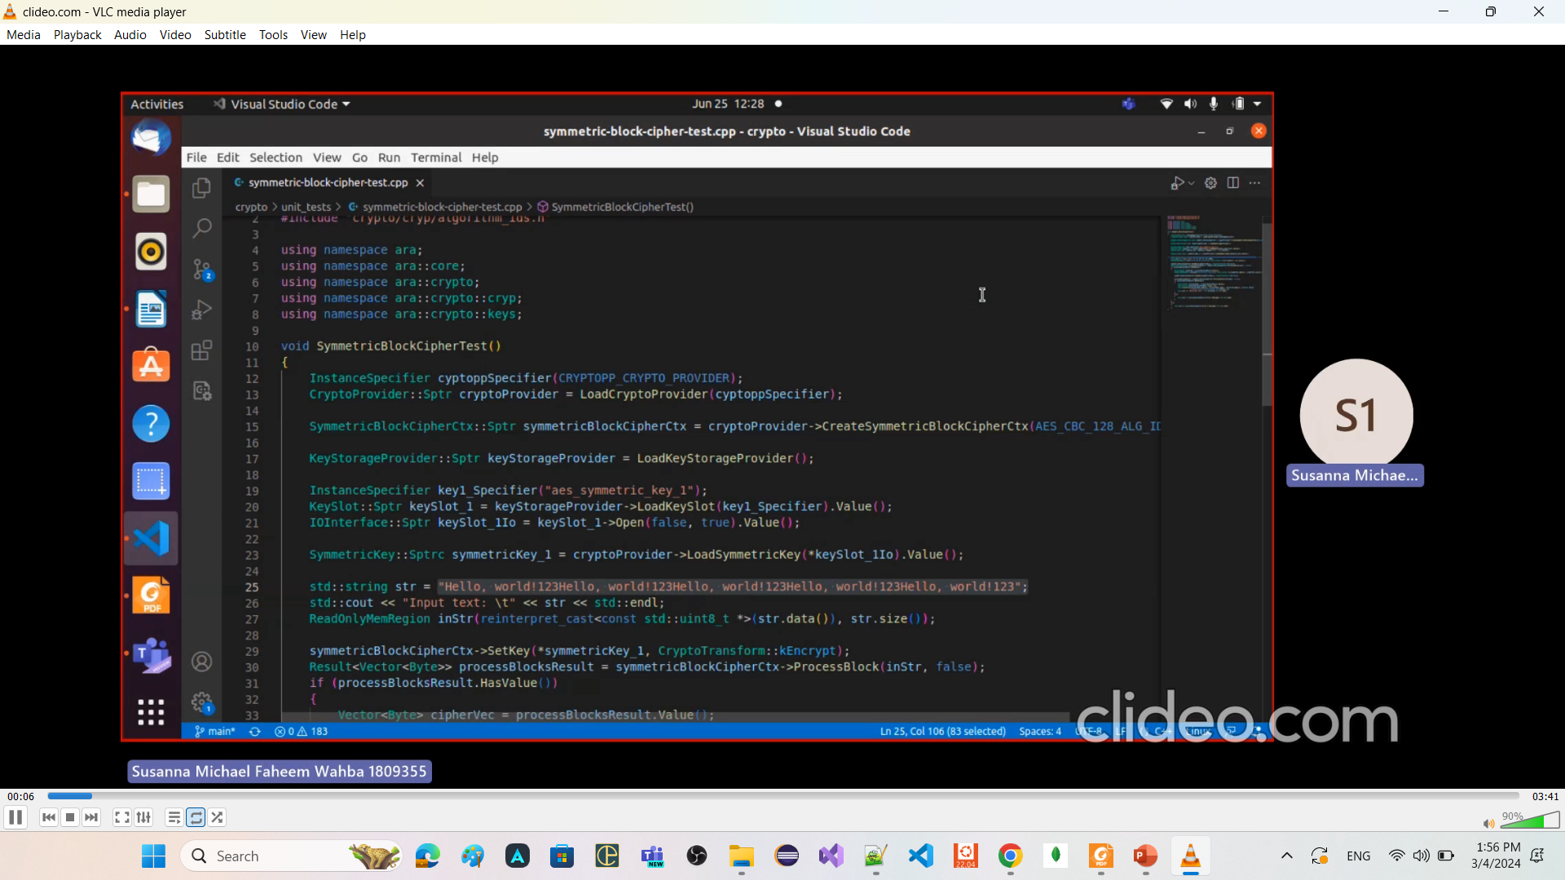
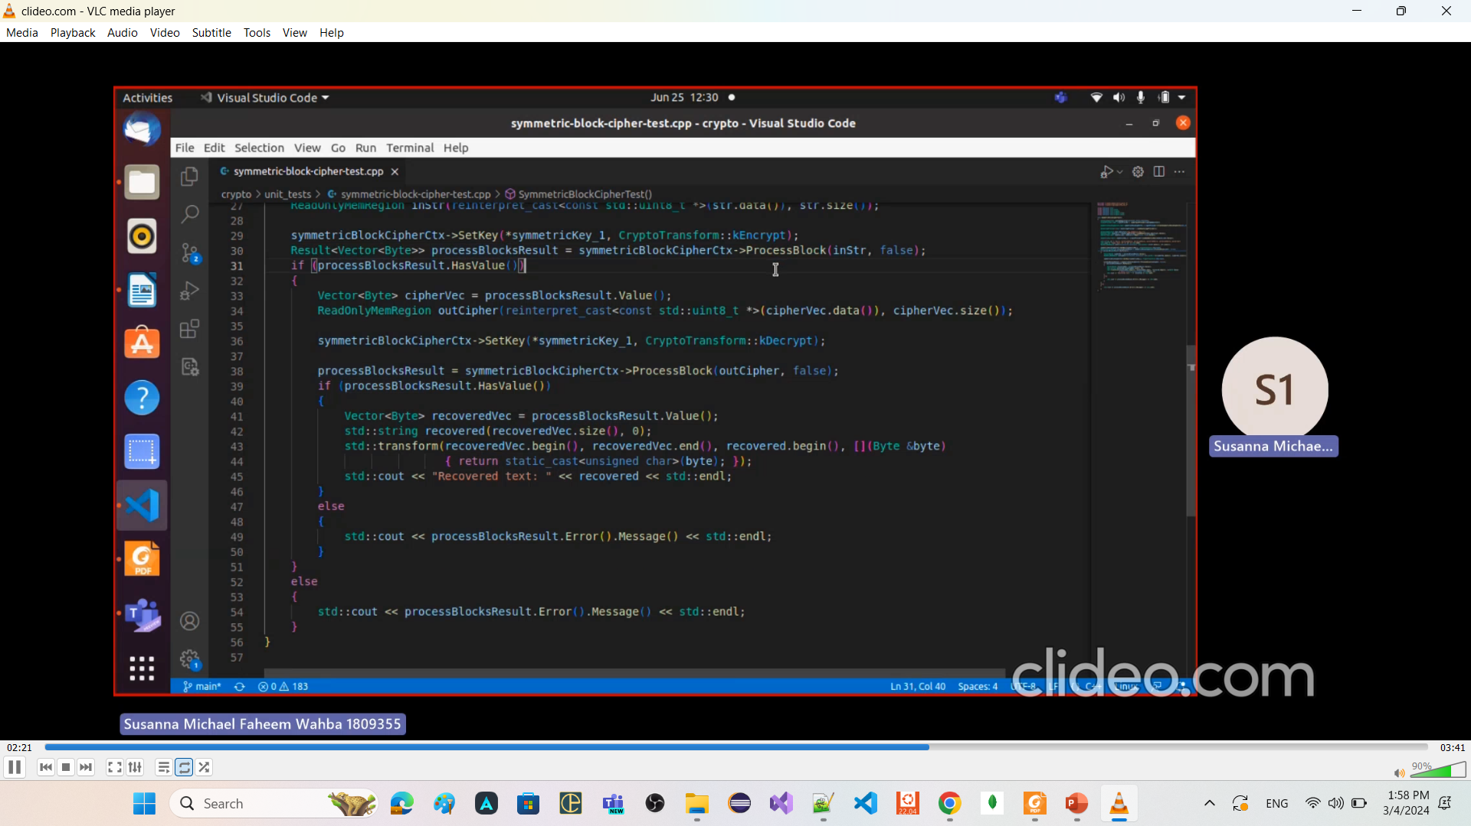
Symmetric Encryption and decryption

Slide 74
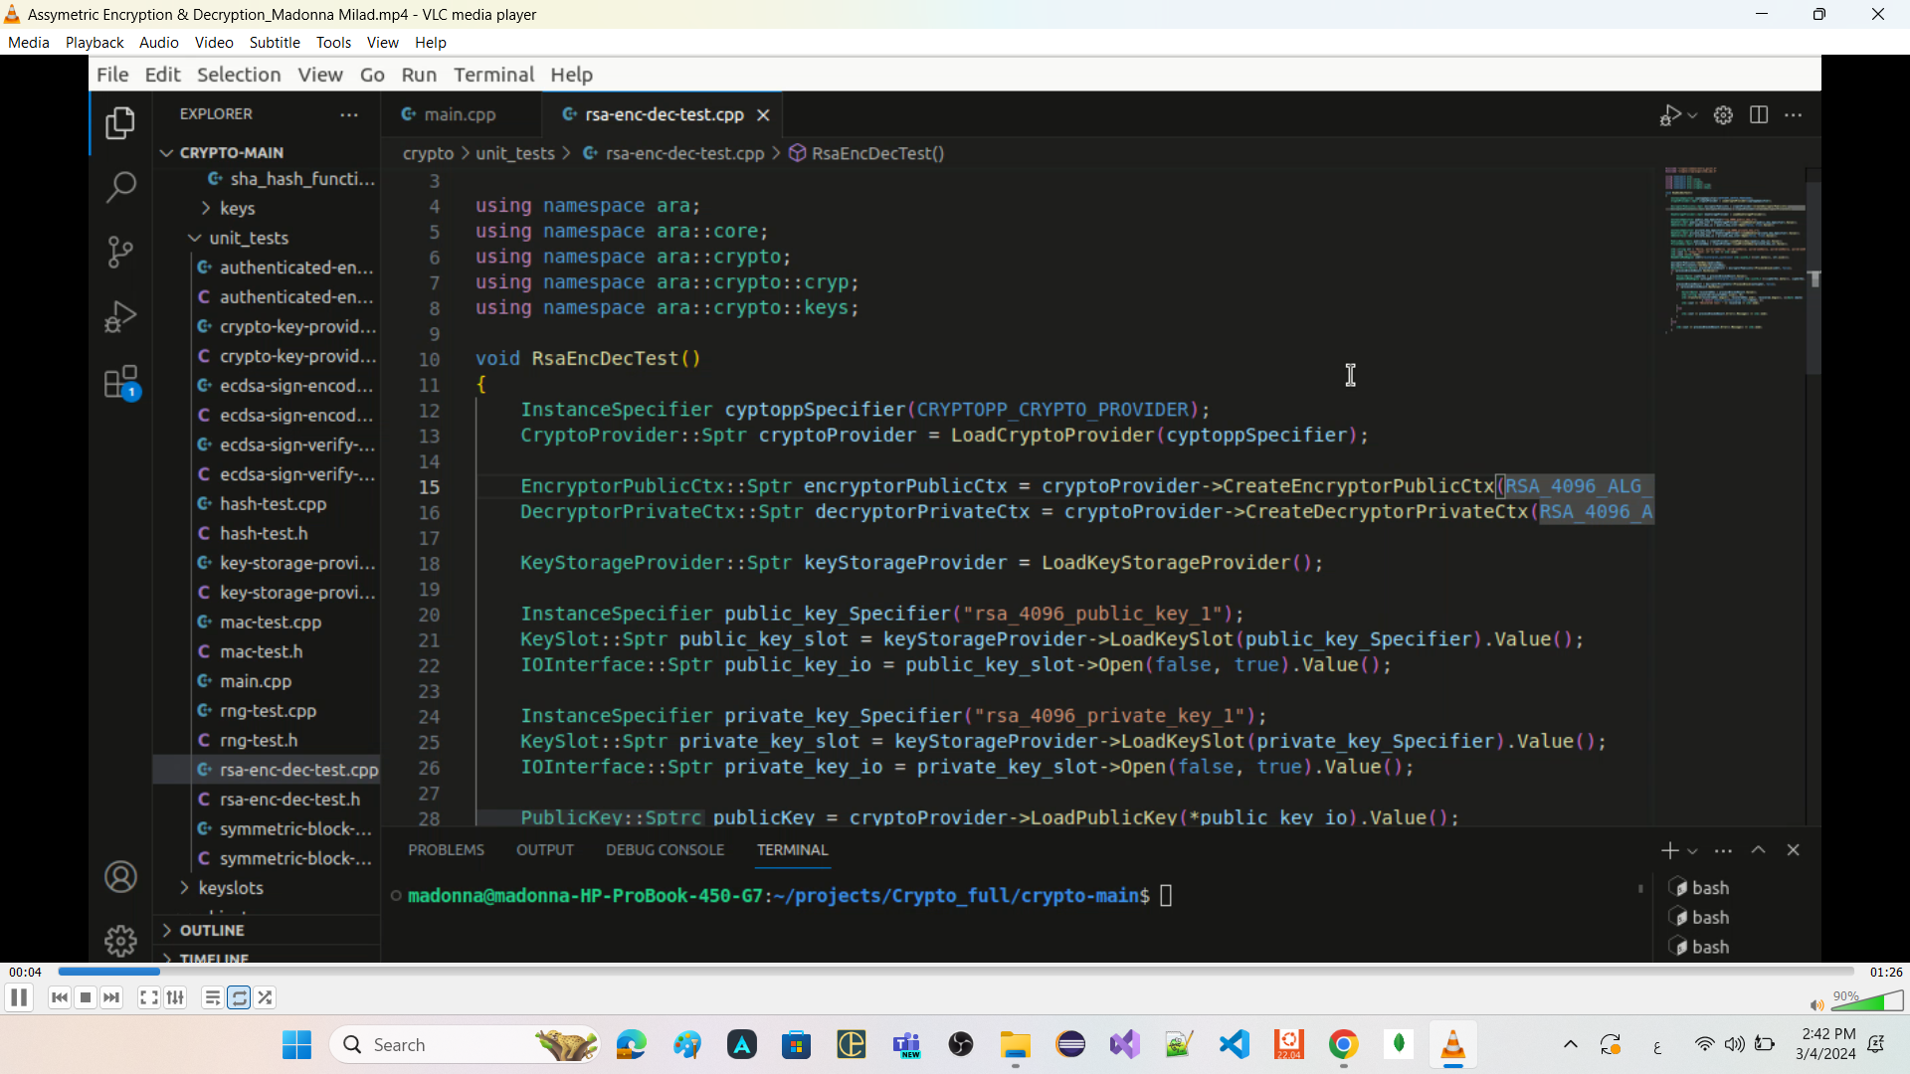
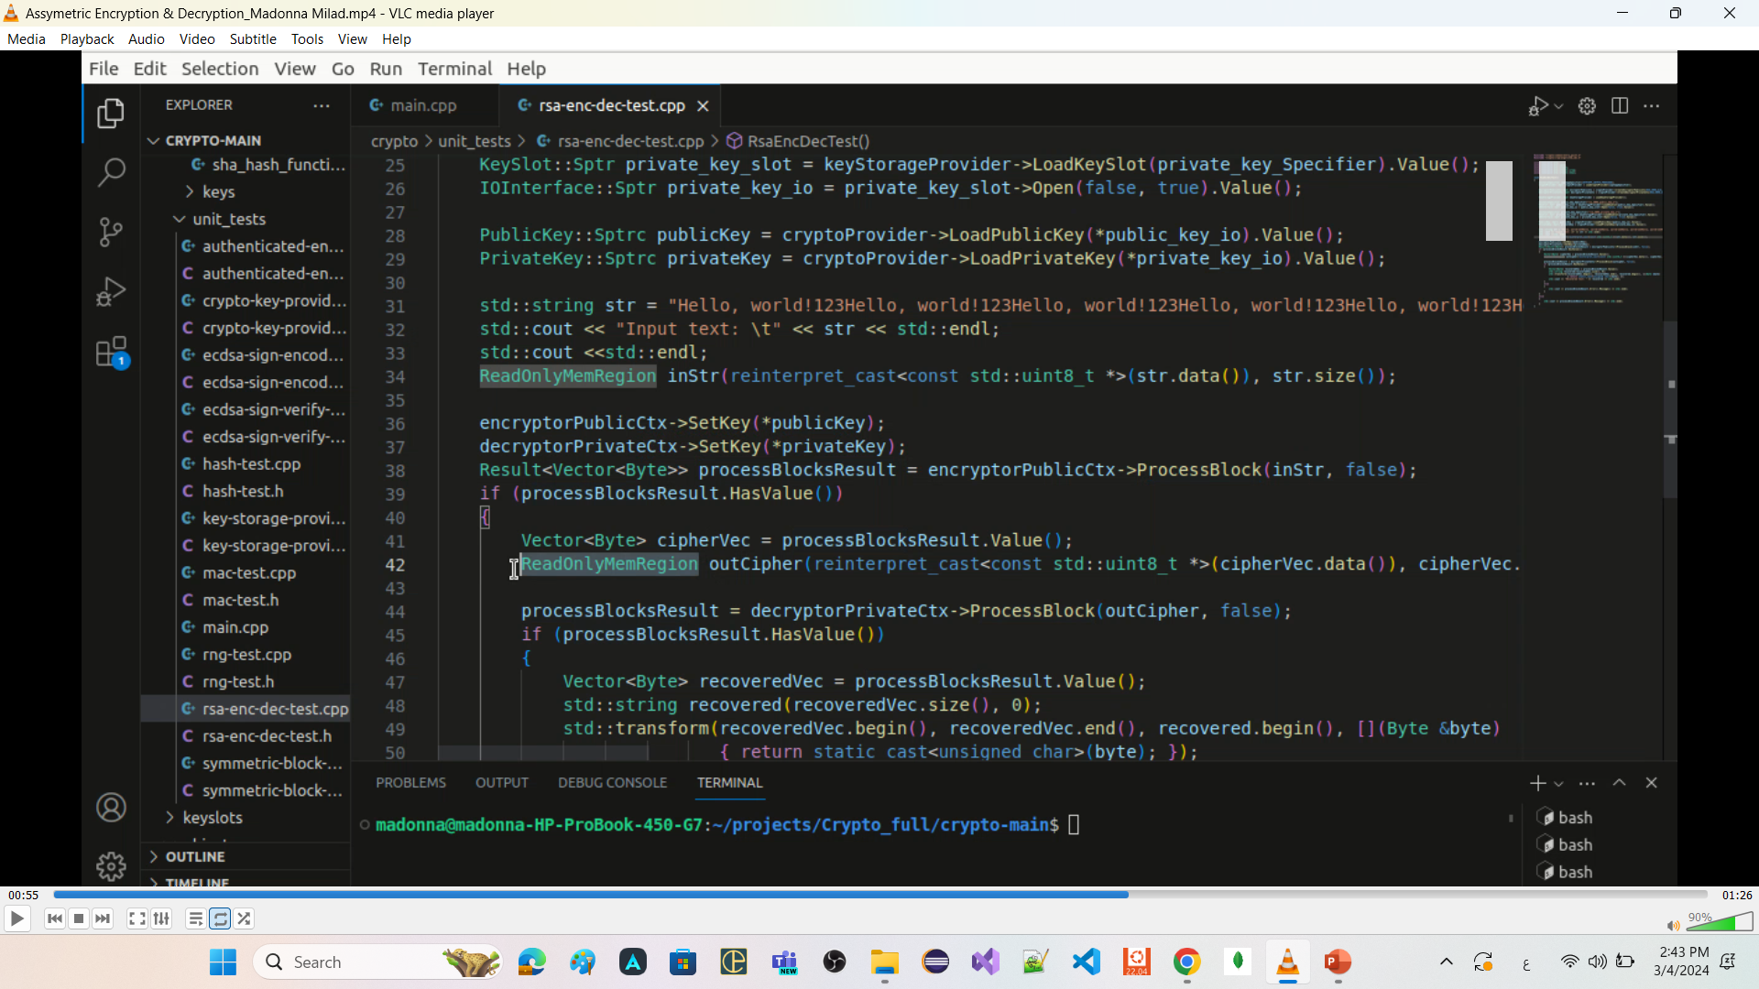
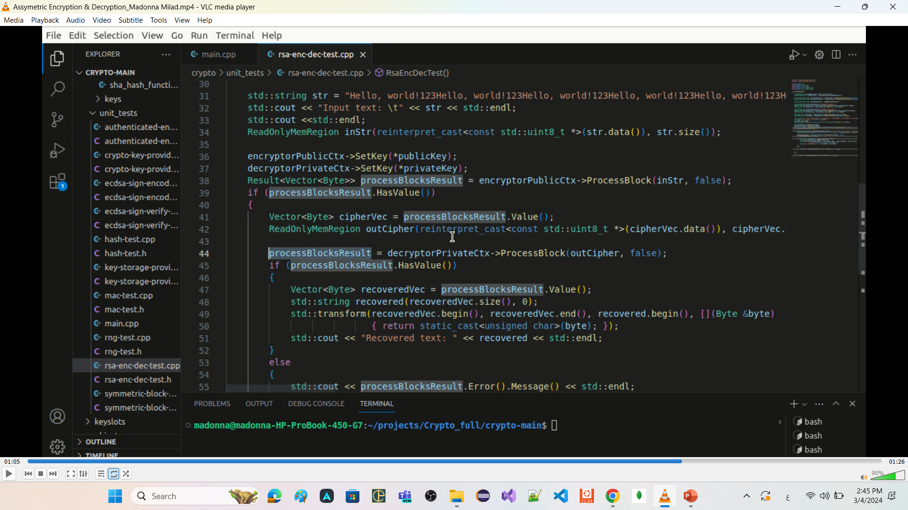
Asymmetric Encryption and decryption

Slide 75
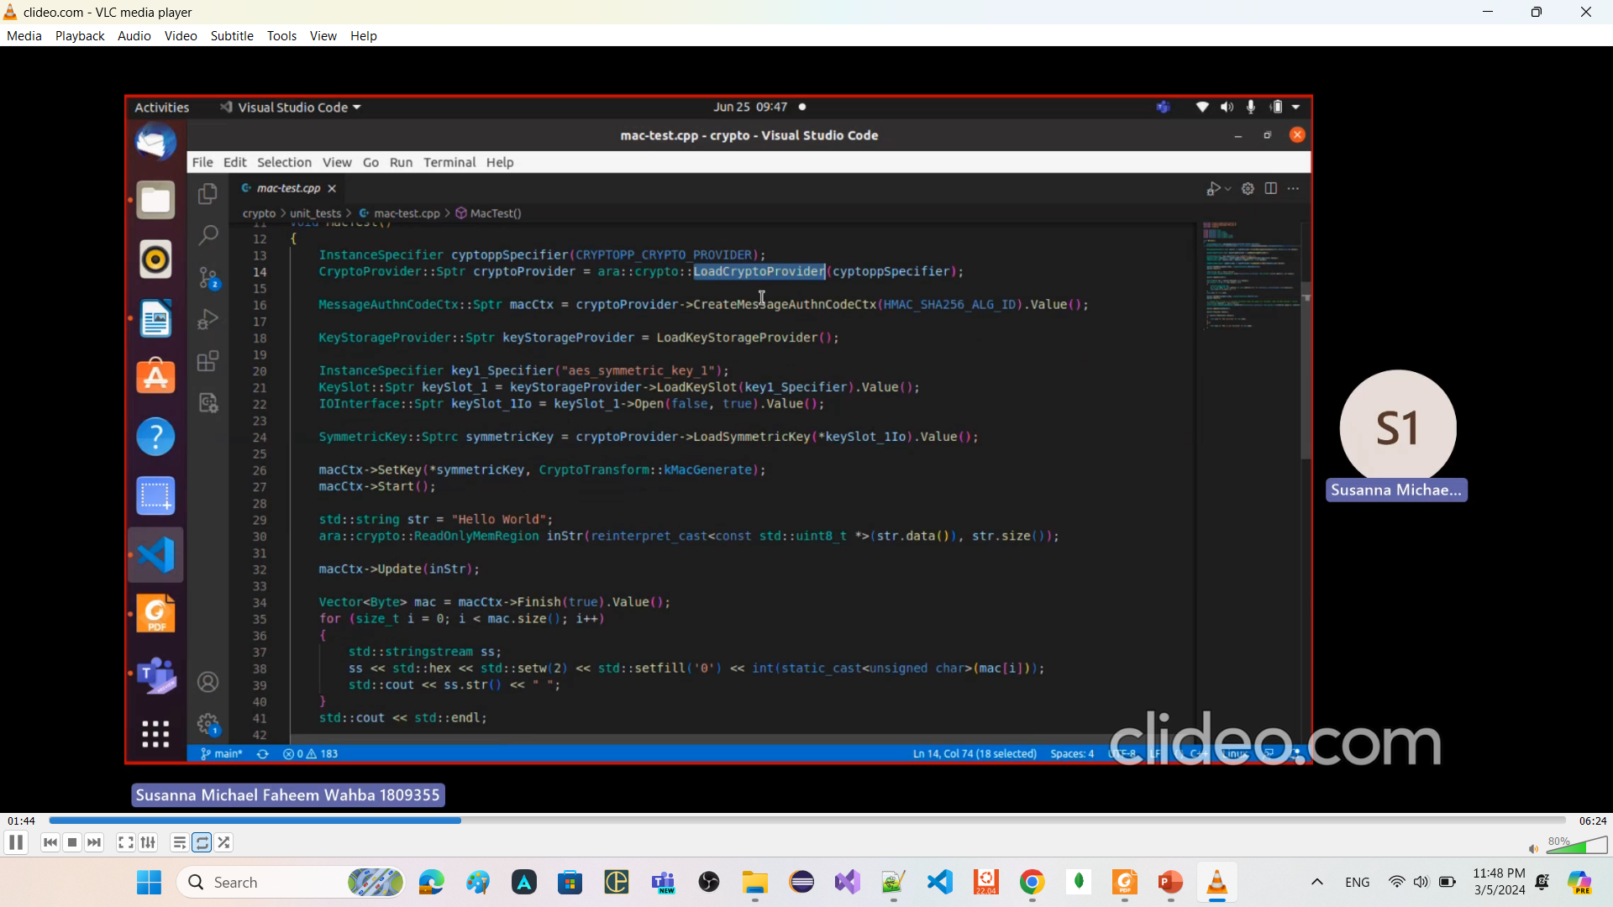
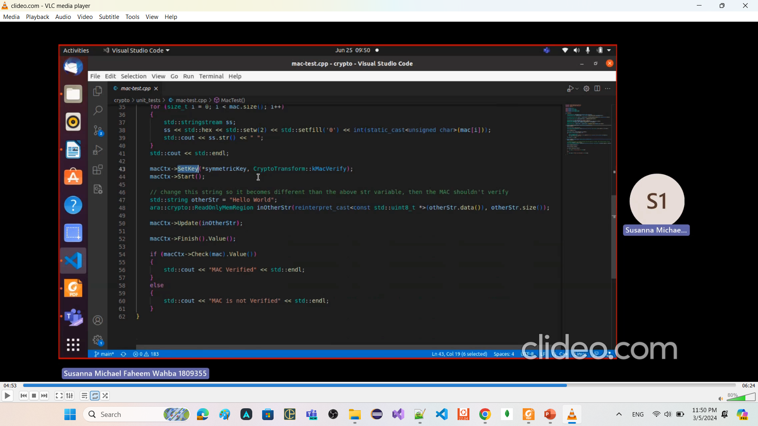
Message authentication Using HMAC_SHA256

Slide 76
Needed Core Classes

Slide 77
Std::span
a C++20 class template that provides a view over a contiguous sequence of elements.
"view" refers to a lightweight object that provides a way to look at or access elements of a data structure
without owning the data itself.
without making a copy of the data
particularly useful for passing
array or sub-array
std::array or sub-std::array
std::vector or sub-std::vector
to functions without the need for copying.

